Slide 1
Hypothesis Networks
Brandon Klein
Last Updated: November 15, 2017

Slide 2
db7.2 Hypothesis Network
14 Nodes and 23 Edges
db7 + 2 edges in db5 that did not appear in any hypothesis networks (STB5→HAP4, HMO1→HMO1).
Parameter | Value
LSE | 0.7073
Penalty | 3.8874
min LSE | 0.4892
iteration count | 52430
LSE:minLSE ratio | 1.4459

Slide 3
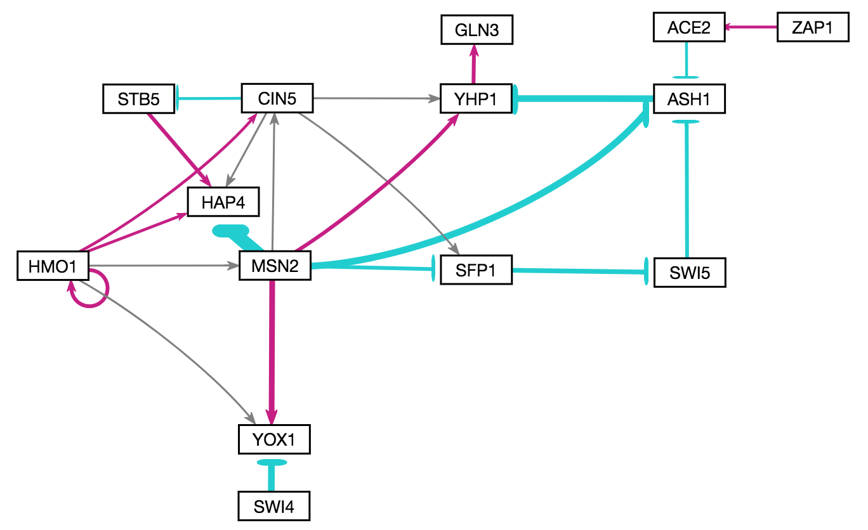
db7.2 Hypothesis Network

Slide 4
db7.2 Hypothesis Network
Gene | wt MSE | dcin5 MSE | dgln3 MSE | dhap4 MSE | dhmo1 MSE | dzap1 MSE
ACE2 | 0.4131 | 0.0964 | 1.3014 | 0.1500 | 0.2133 | 0.8475
ASH1 | 0.3184 | 0.5158 | 0.5860 | 0.3396 | 1.0920 | 1.1995
CIN5 | 0.8574 | 0.1450 | 0.8850 | 1.1710 | 0.7703 | 0.6892
GLN3 | 0.4818 | 0.1967 | 0.3533 | 0.1946 | 0.2439 | 0.1780
HAP4 | 2.0758 | 1.2028 | 1.5276 | 0.4916 | 1.3940 | 0.5857
HMO1 | 0.6175 | 0.6585 | 0.2993 | 2.8592 | 0.5936 | 0.5179
MSN2 | 0.5539 | 0.4245 | 0.7706 | 0.1934 | 0.6530 | 0.2576
SFP1 | 0.9870 | 0.3024 | 0.9611 | 0.1831 | 1.1907 | 0.3043
STB5 | 1.7757 | 0.8727 | 0.4008 | 0.1705 | 0.5190 | 1.3426
SWI4 | 0.3000 | 0.7351 | 0.4610 | 0.2057 | 0.3087 | 0.2437
SWI5 | 0.4343 | 0.2257 | 0.2776 | 0.5042 | 0.2530 | 0.2674
YHP1 | 0.7875 | 0.6562 | 0.8921 | 0.3132 | 0.3063 | 0.4794
YOX1 | 0.4142 | 0.7603 | 1.4228 | 0.7967 | 0.6774 | 0.5560
ZAP1 | 2.3039 | 0.6735 | 1.2801 | 1.1287 | 0.4608 | 3.1590

Slide 5
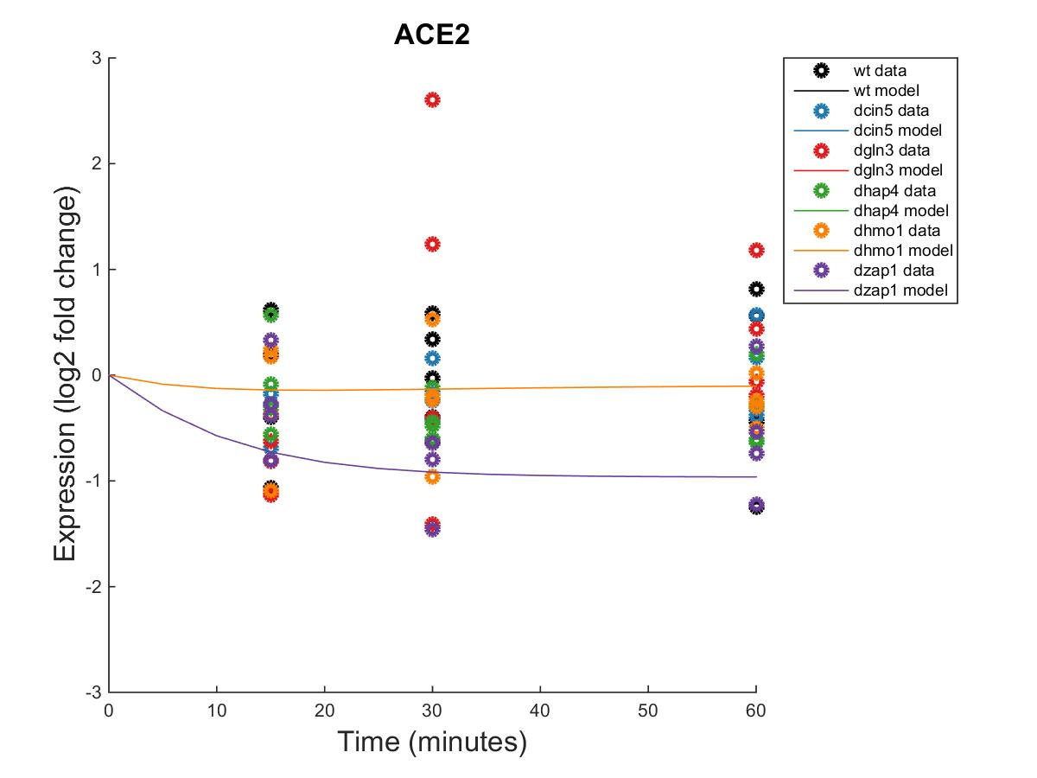
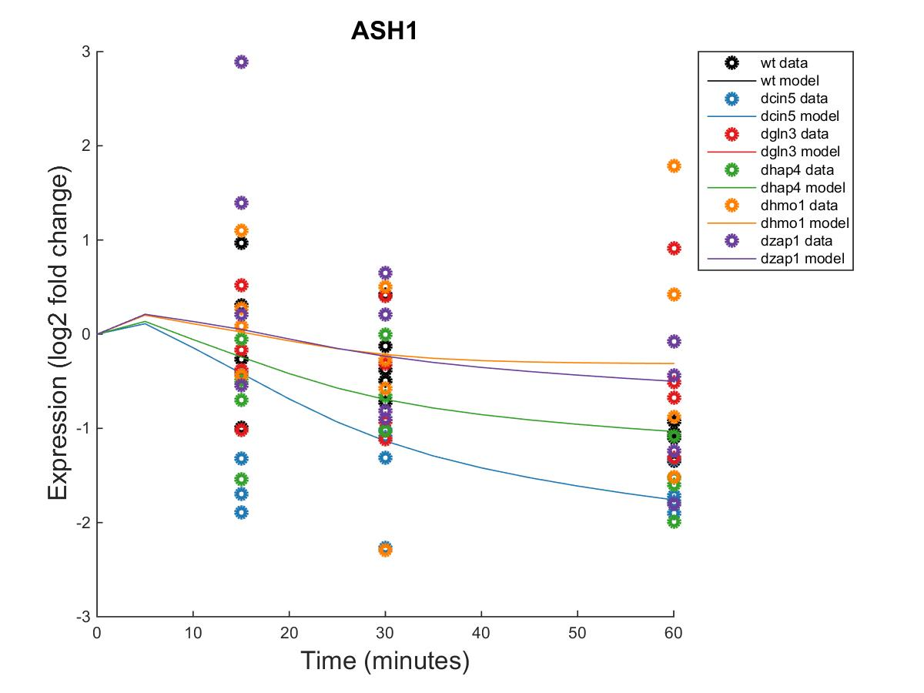
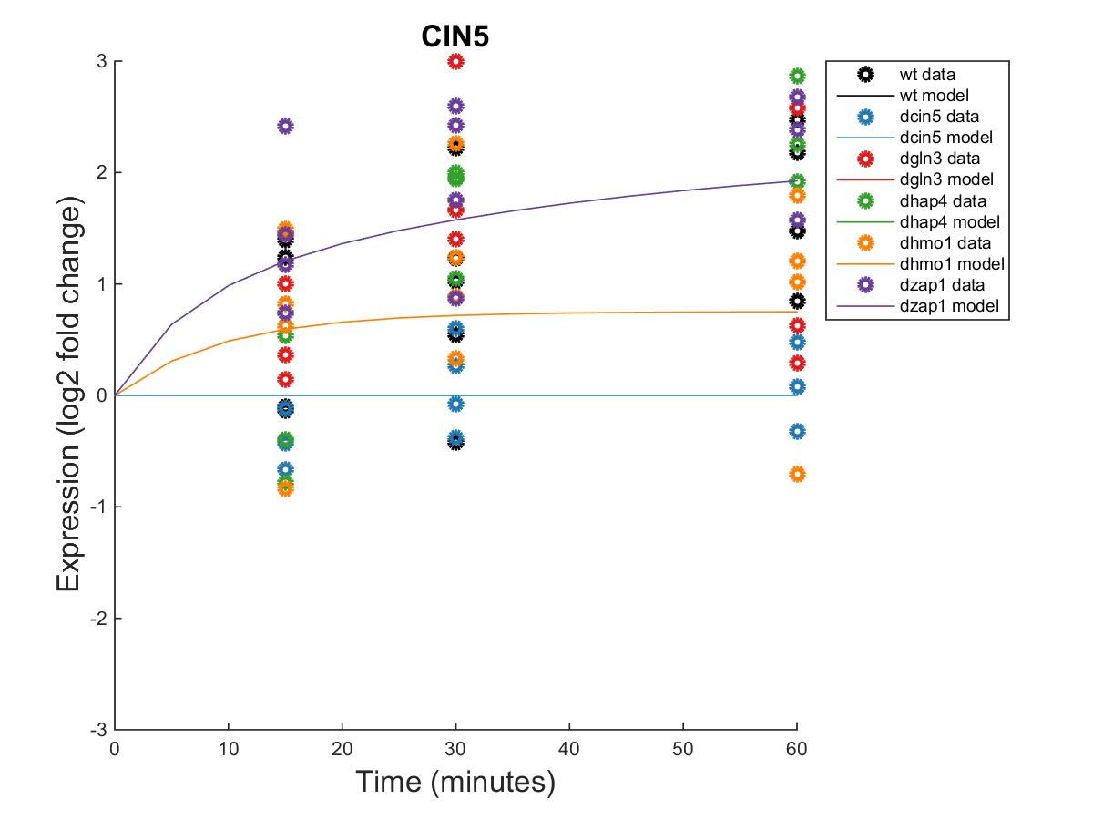
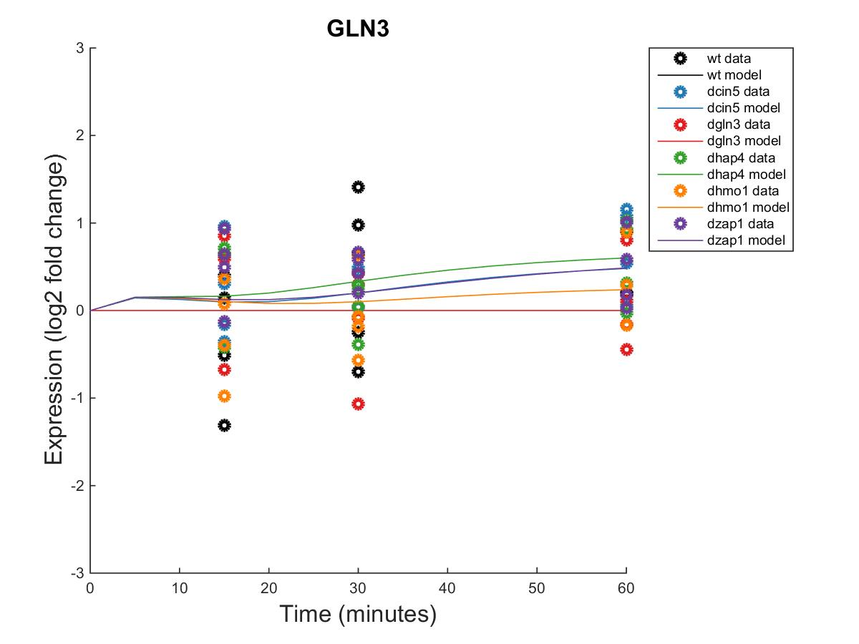
db7.2 Hypothesis Network

Slide 6
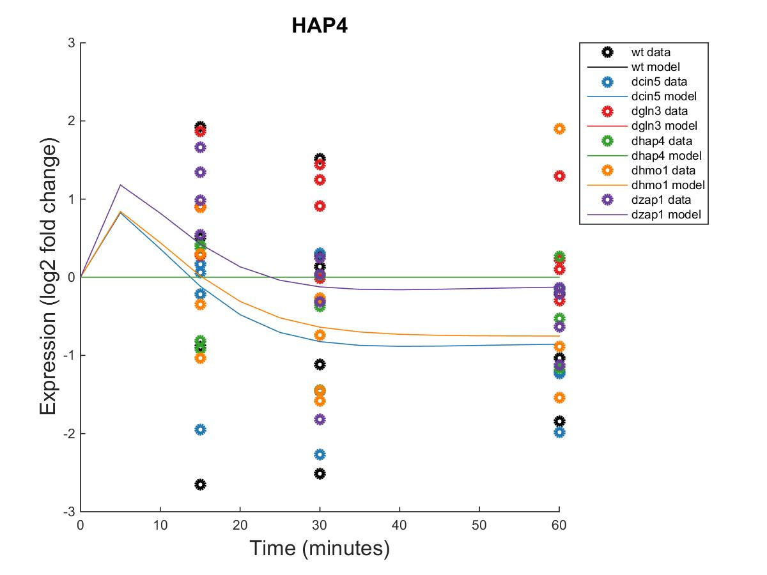
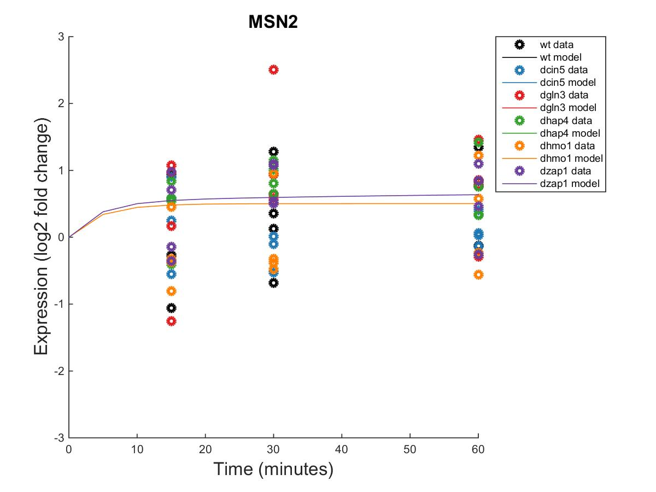
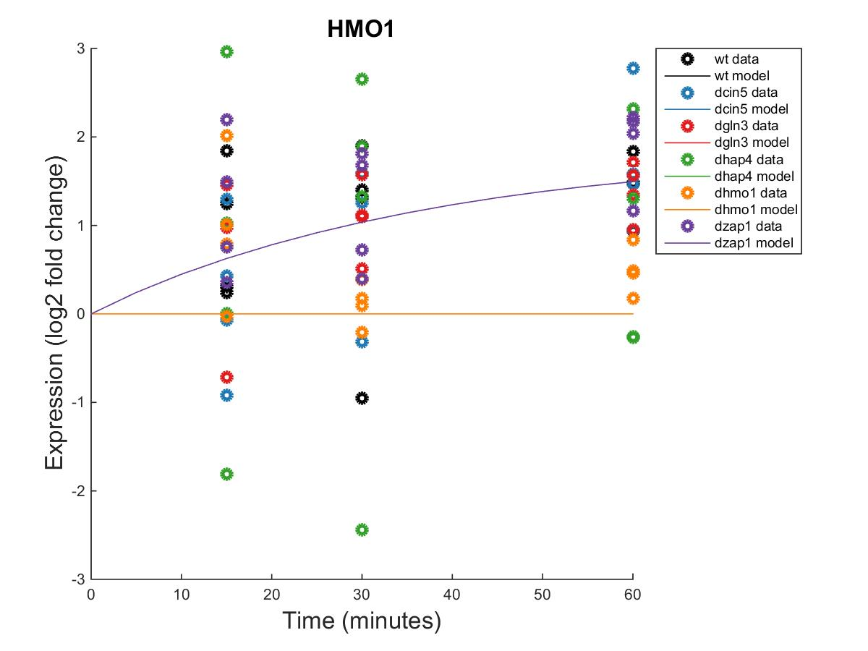
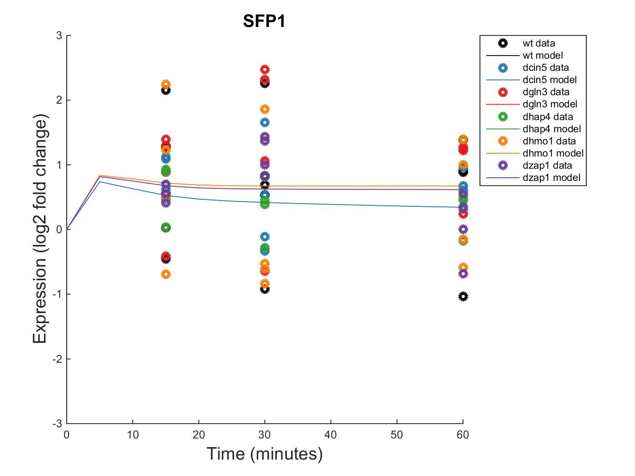
db7.2 Hypothesis Network

Slide 7
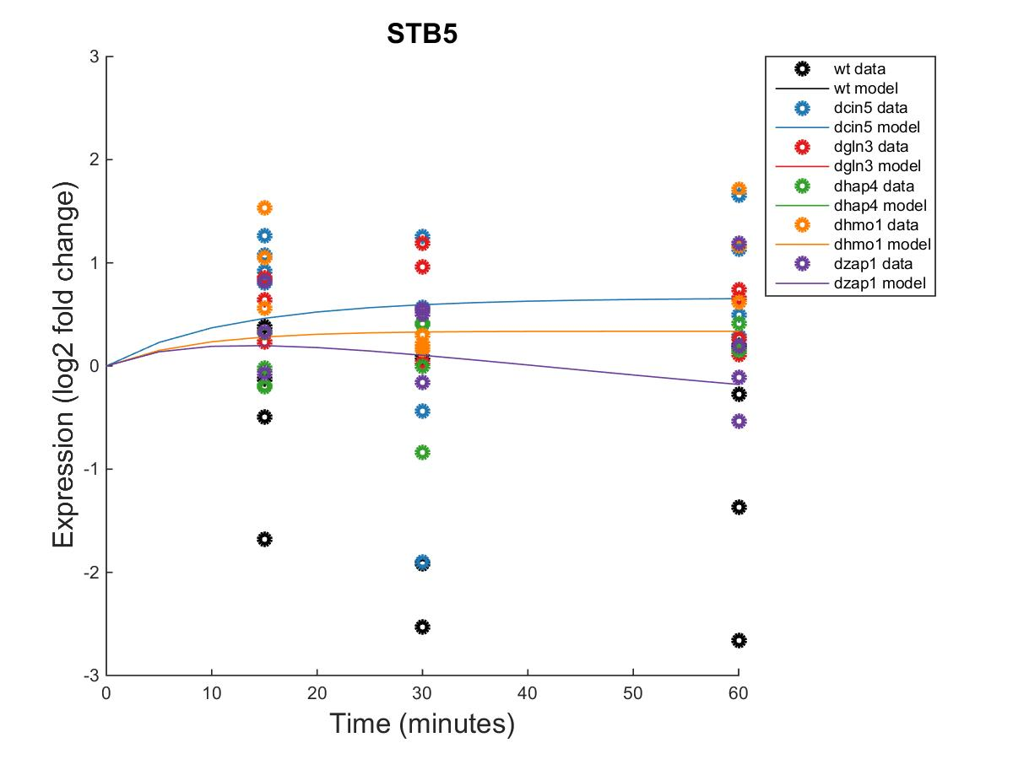
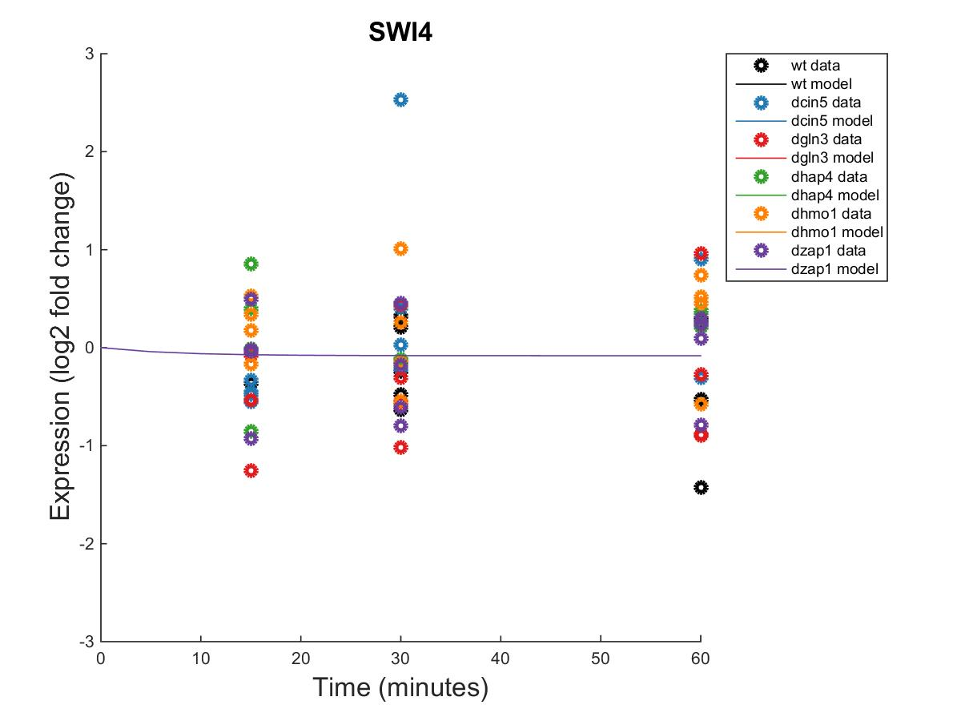
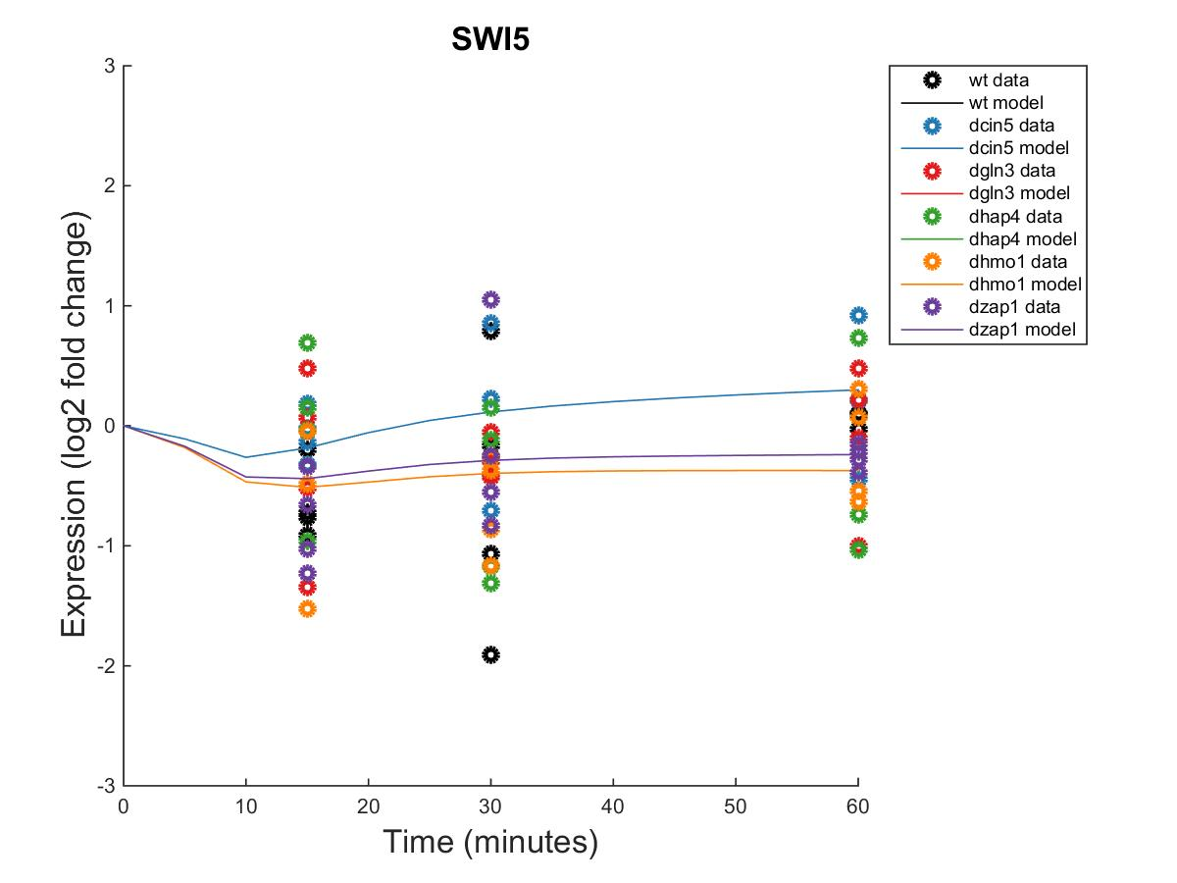
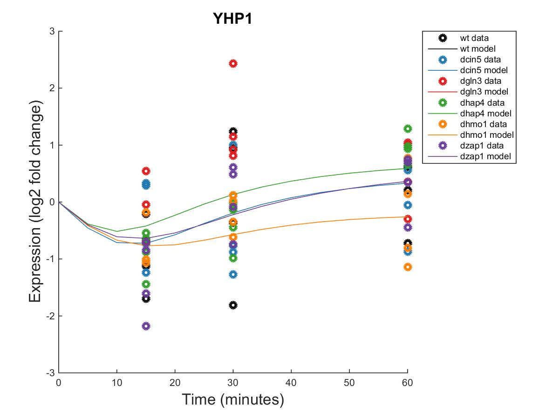
db7.2 Hypothesis Network

Slide 8
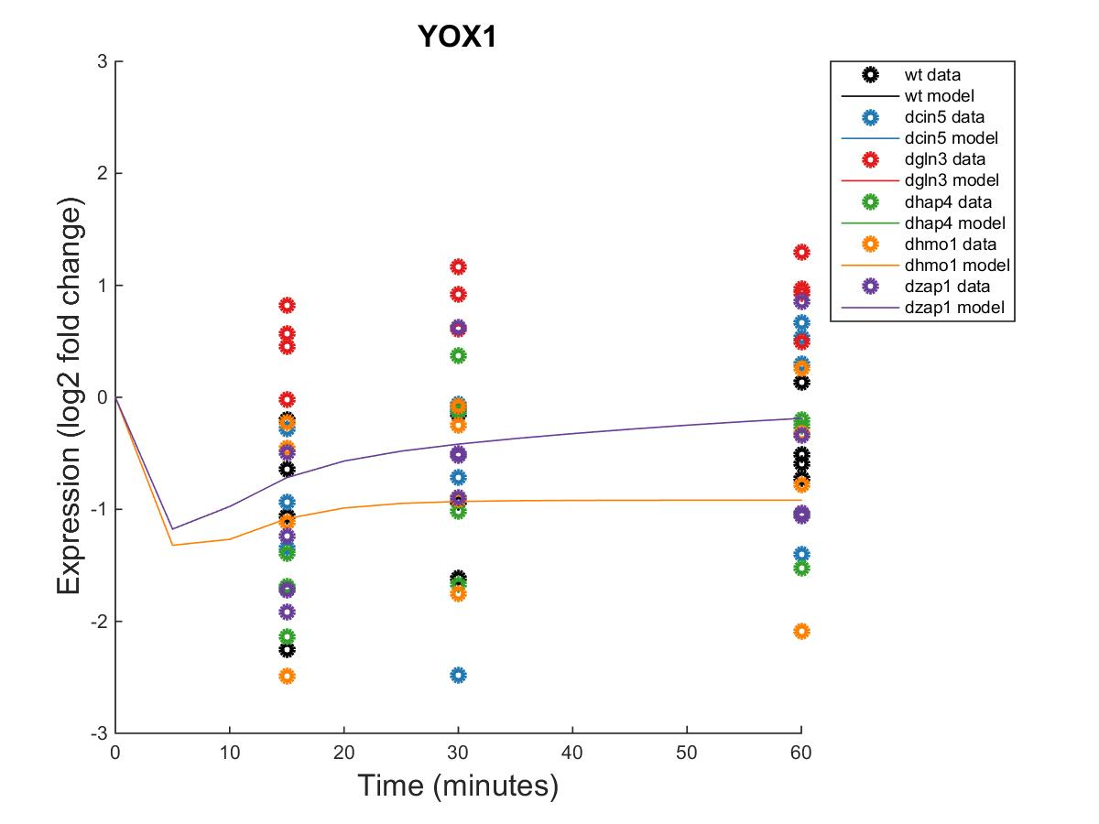
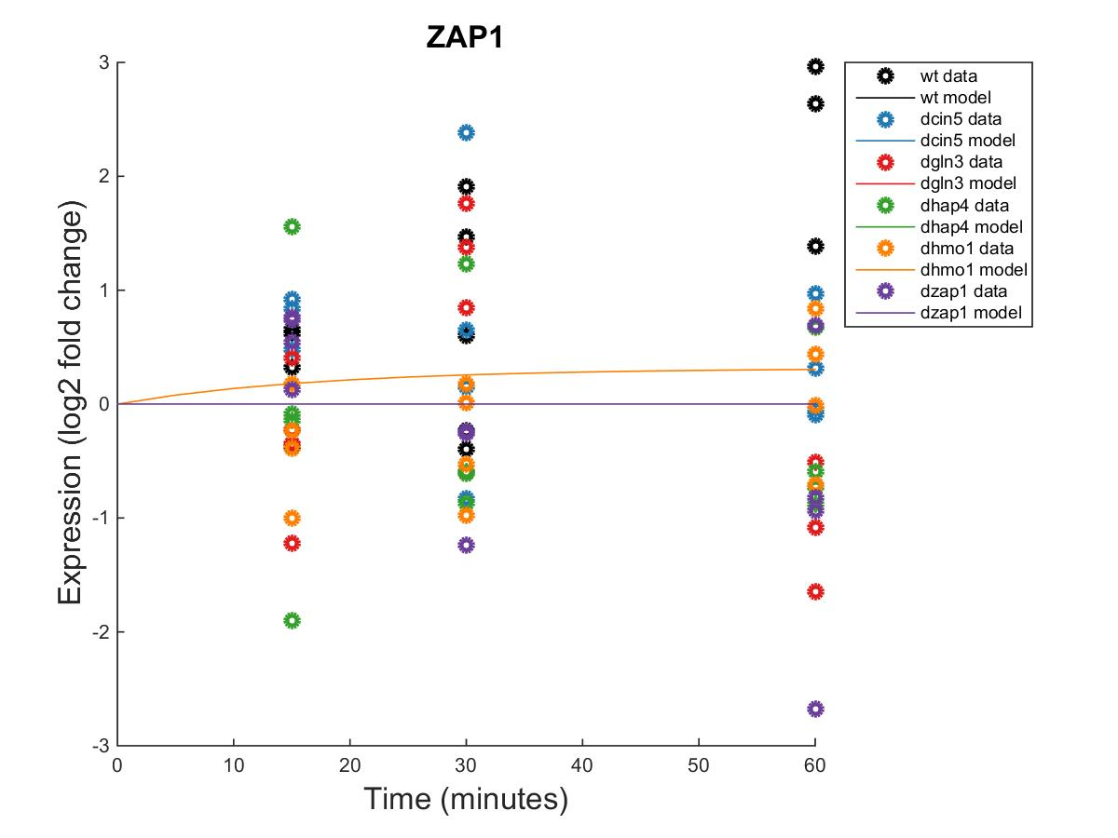
db7.2 Hypothesis Network

Slide 9
db7.2 Hypothesis Network
id | production_rate | threshold_b
ACE2 | 0.1669 | 0.6483
ASH1 | 2.7655 | -3.8272
CIN5 | 0.6456 | 1.4117
GLN3 | 0.3364 | 0.6651
HAP4 | 3.5703 | -4.9367
HMO1 | 0.1882 | 1.1663
MSN2 | 0.9240 | 0.7876
SFP1 | 2.1689 | -0.7958
STB5 | 0.1473 | -1.1065
SWI4 | 0.2674 | 0.0000
SWI5 | 0.9406 | -0.9657
YHP1 | 0.1632 | 0.4087
YOX1 | 1.4125 | 2.3133
ZAP1 | 0.1298 | 0.0000

Slide 10
db5: Edge-Derived Hypothesis Network
15 Nodes and 25 Edges
Edges represented 2+ time among db5 and the five best performing db5-derived networks (23) + 2 edges in db5 that did not appear in any hypothesis networks (STB5→HAP4, HMO1→HMO1).
Parameter | Value
LSE | 0.7093
Penalty | 2.6293
min LSE | 0.4851
iteration count | 97931
LSE:minLSE ratio | 1.4622

Slide 11
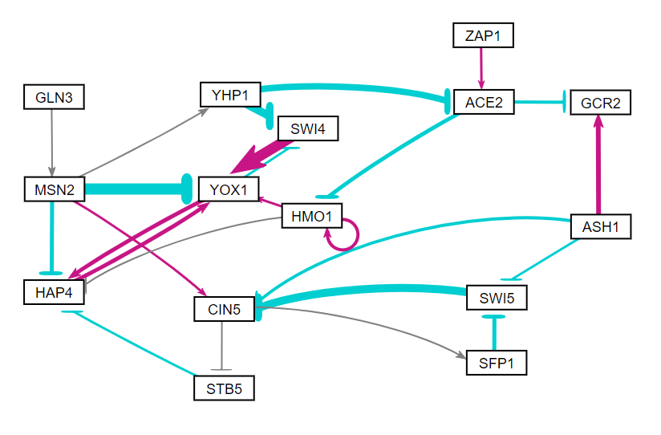
db5: Edge-Derived Hypothesis Network

Slide 12
db5: Edge-Derived Hypothesis Network
Gene | wt MSE | dcin5 MSE | dgln3 MSE | dhap4 MSE | dhmo1 MSE | dzap1 MSE
ACE2 | 0.4148 | 0.0851 | 1.2429 | 0.1618 | 0.2143 | 0.8548
ASH1 | 0.4495 | 1.0218 | 0.4847 | 0.4892 | 1.3122 | 1.7388
CIN5 | 0.7406 | 0.1450 | 0.8325 | 1.1448 | 1.0959 | 0.8440
GCR2 | 0.4172 | 0.7608 | 0.8039 | 0.9841 | 0.4924 | 0.2072
GLN3 | 0.5393 | 0.2280 | 0.3533 | 0.2110 | 0.3185 | 0.1449
HAP4 | 1.9099 | 1.2678 | 0.7097 | 0.4916 | 1.3630 | 0.6729
HMO1 | 0.6372 | 0.6498 | 0.3007 | 2.8032 | 0.5936 | 0.4249
MSN2 | 0.5178 | 0.3119 | 0.9144 | 0.2442 | 0.5983 | 0.2692
SFP1 | 0.9924 | 0.2712 | 0.9606 | 0.1862 | 1.1766 | 0.3075
STB5 | 1.9886 | 0.8955 | 0.2803 | 0.1457 | 0.7195 | 1.2985
SWI4 | 0.3284 | 0.6121 | 0.4017 | 0.1793 | 0.2496 | 0.2685
SWI5 | 0.5059 | 0.3061 | 0.2922 | 0.4586 | 0.2989 | 0.3463
YHP1 | 0.8850 | 0.6531 | 1.2342 | 0.7366 | 0.4112 | 0.8799
YOX1 | 0.3770 | 0.7418 | 0.2349 | 0.3792 | 0.6724 | 0.5490
ZAP1 | 2.2896 | 0.6701 | 1.2868 | 1.1358 | 0.4663 | 3.1590

Slide 13
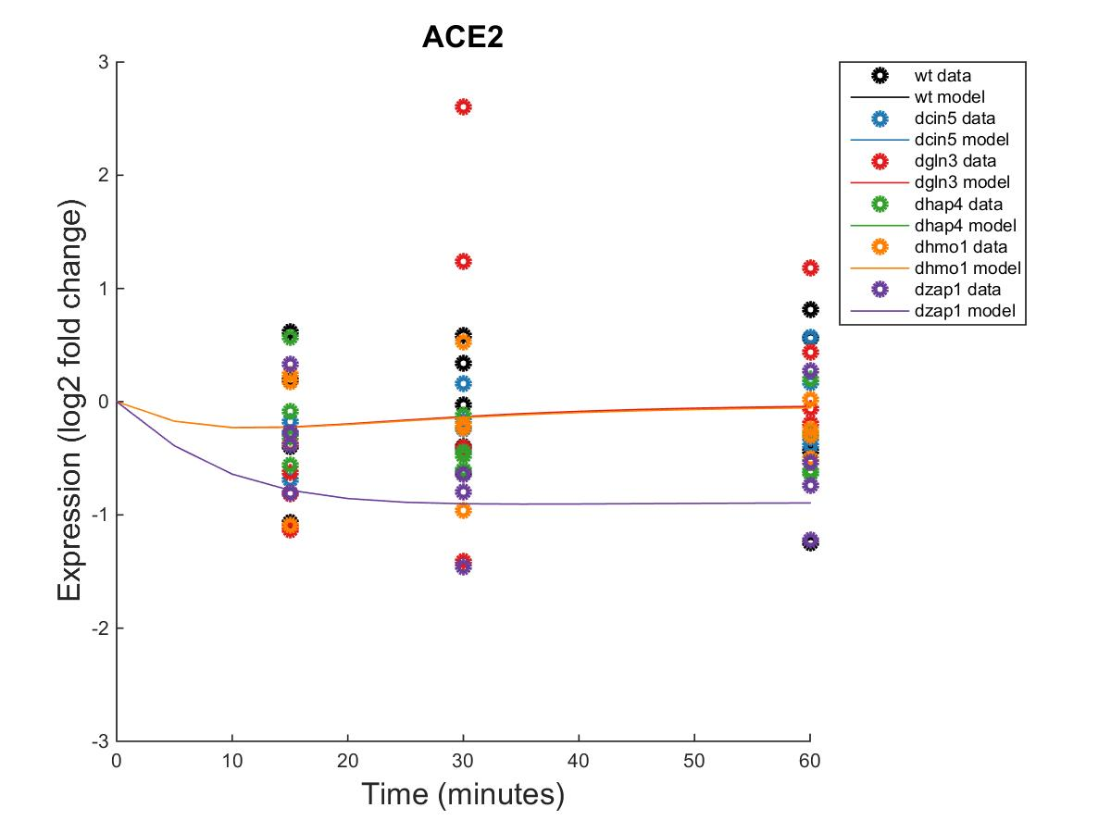
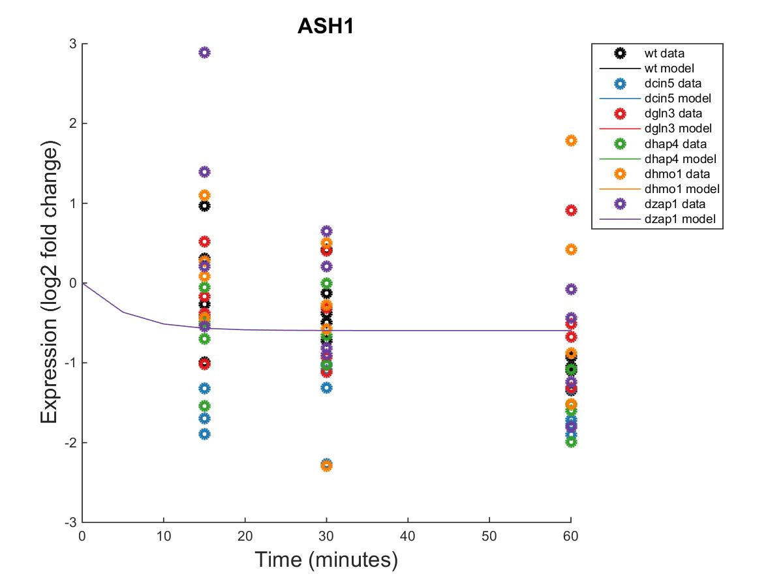
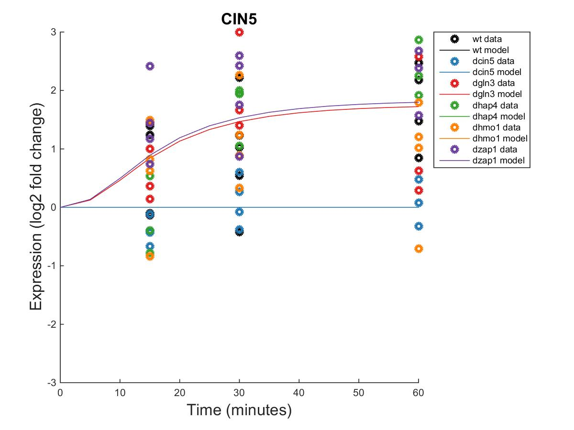
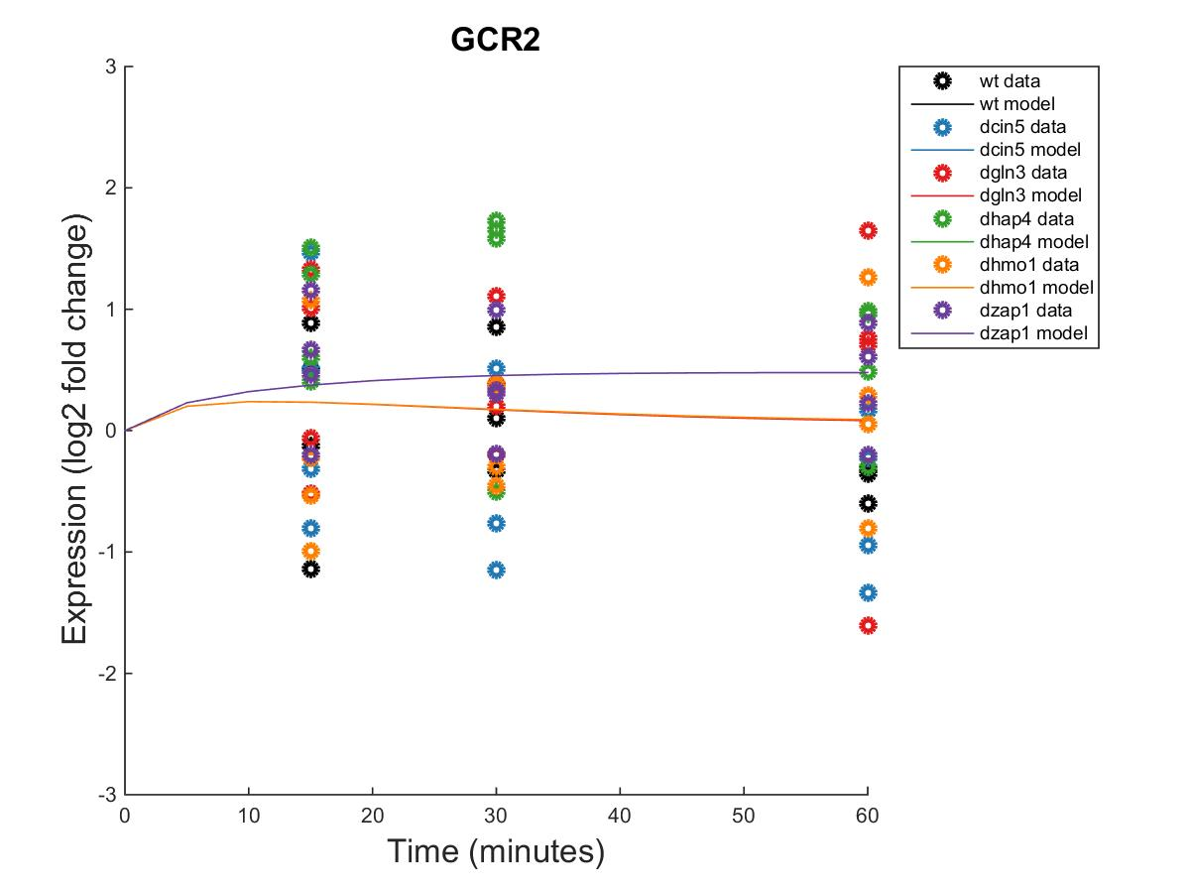
db5: Edge-Derived Hypothesis Network

Slide 14
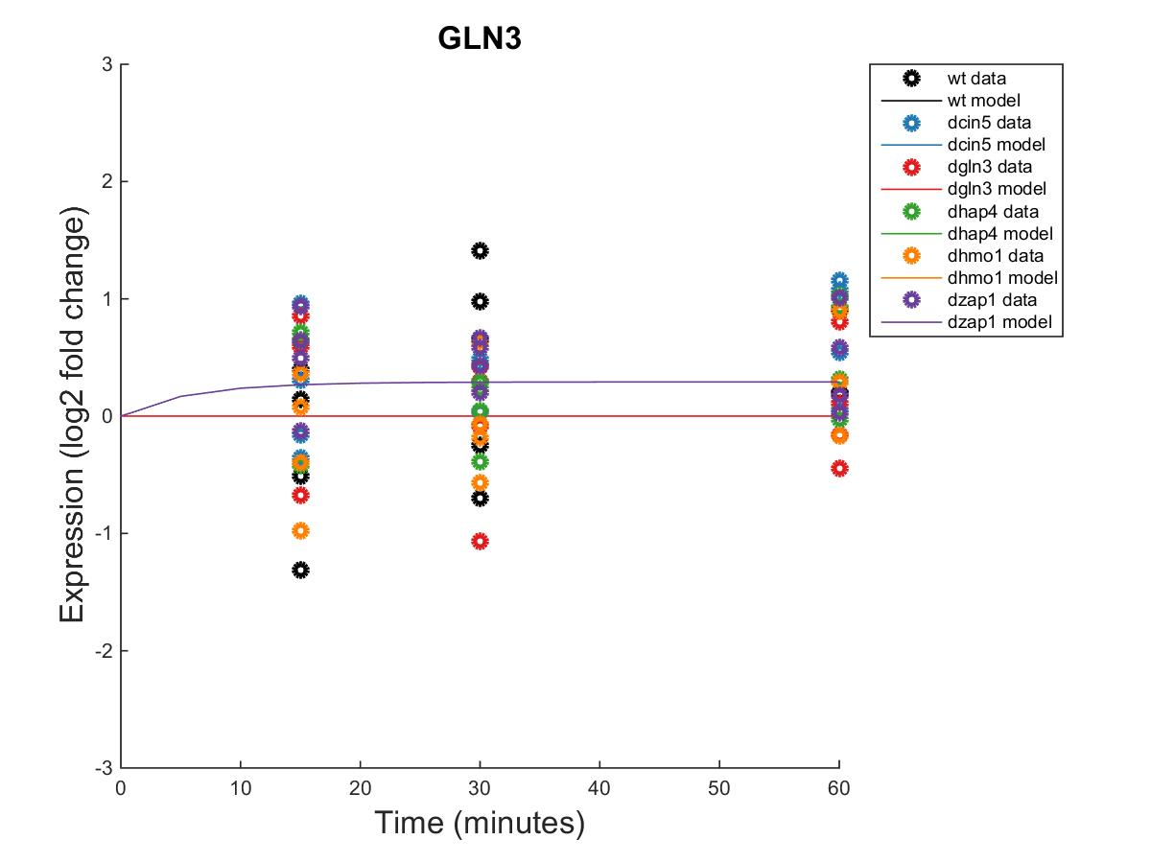
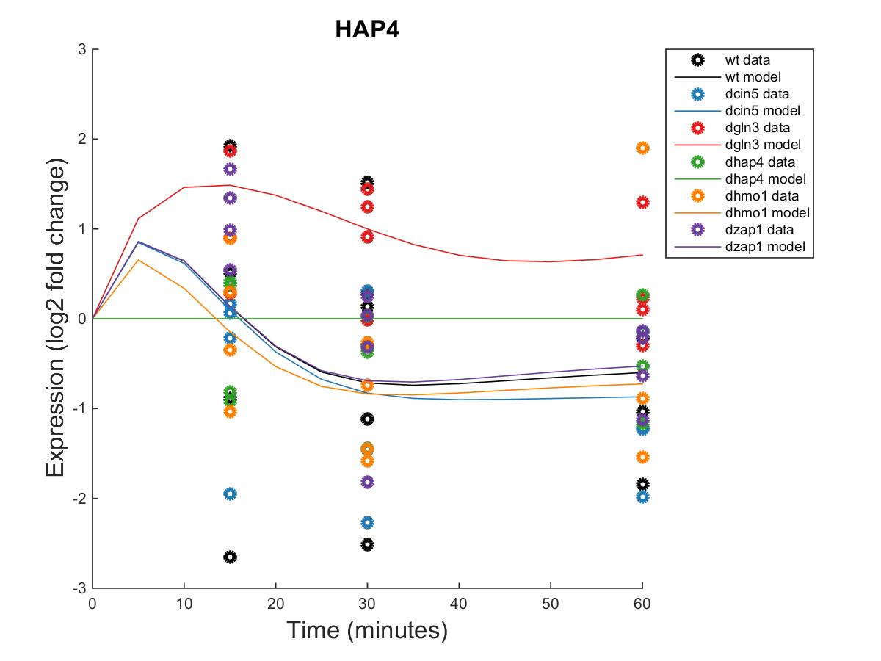
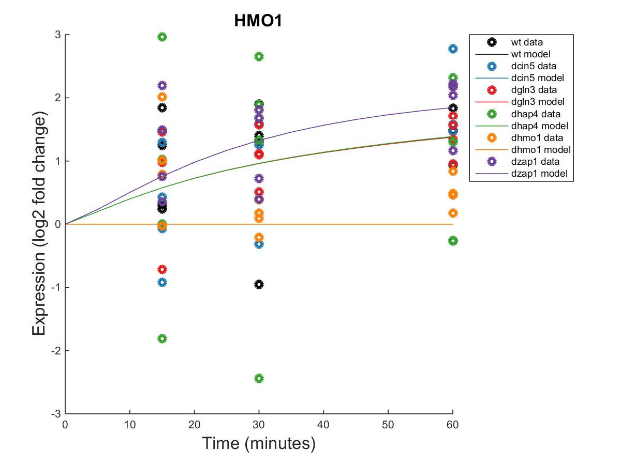
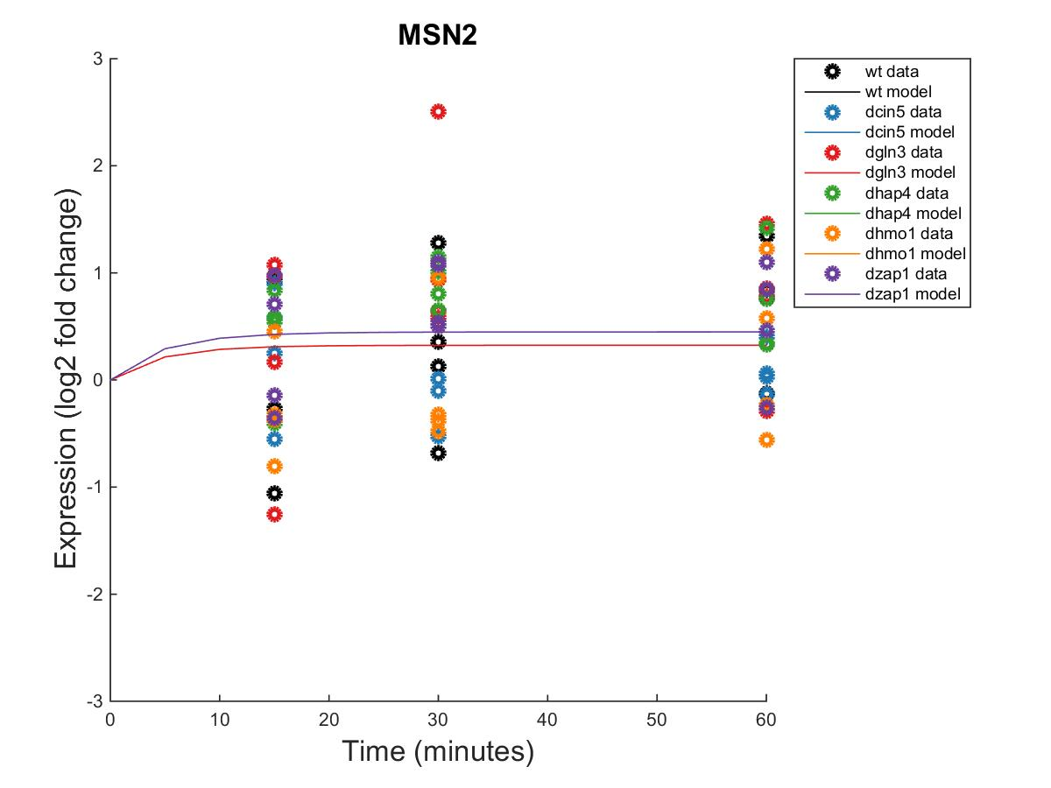
db5: Edge-Derived Hypothesis Network

Slide 15
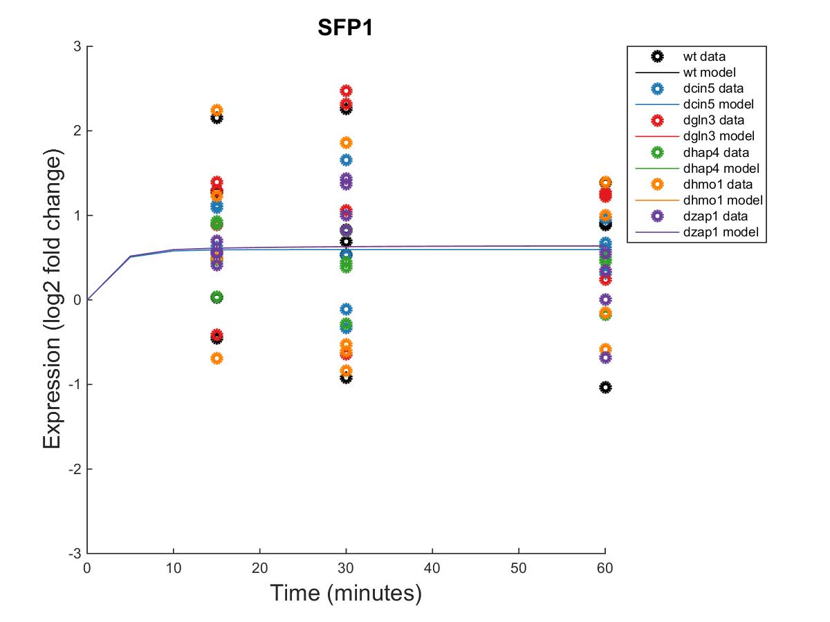
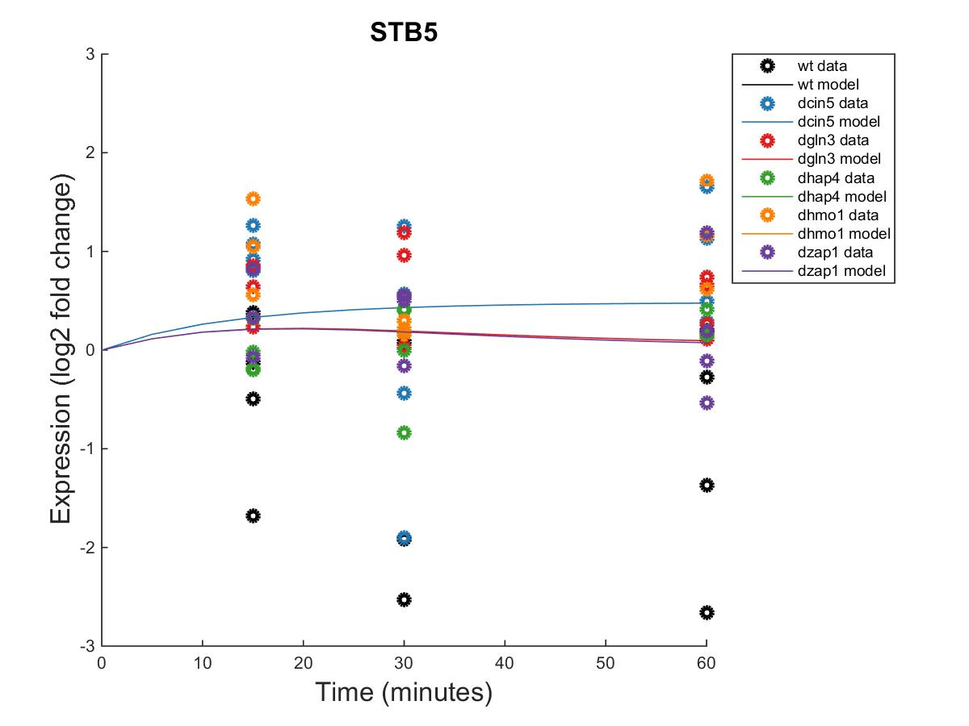
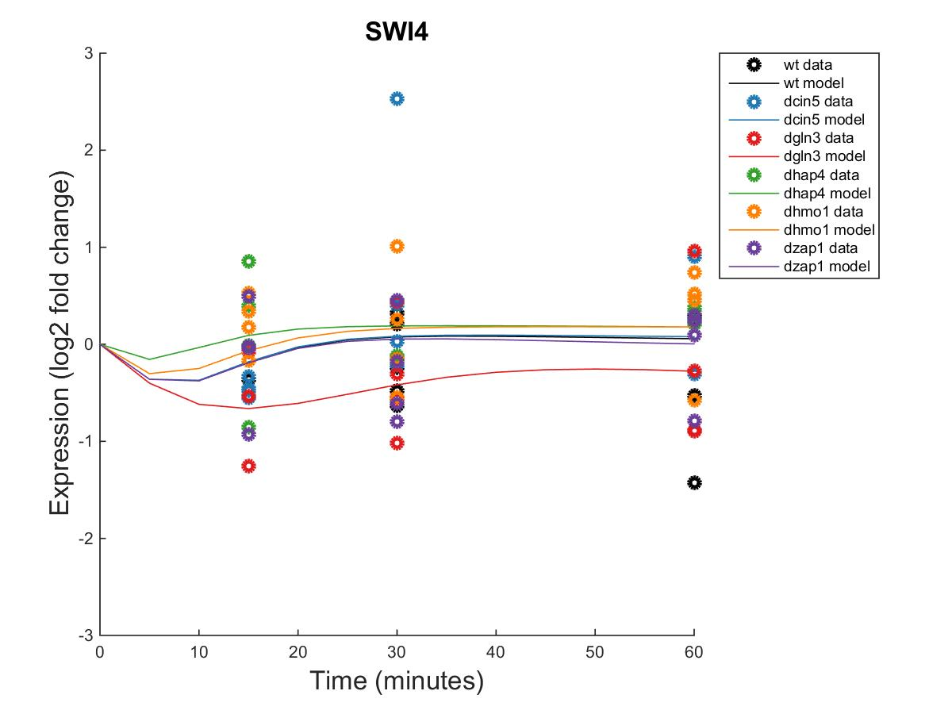
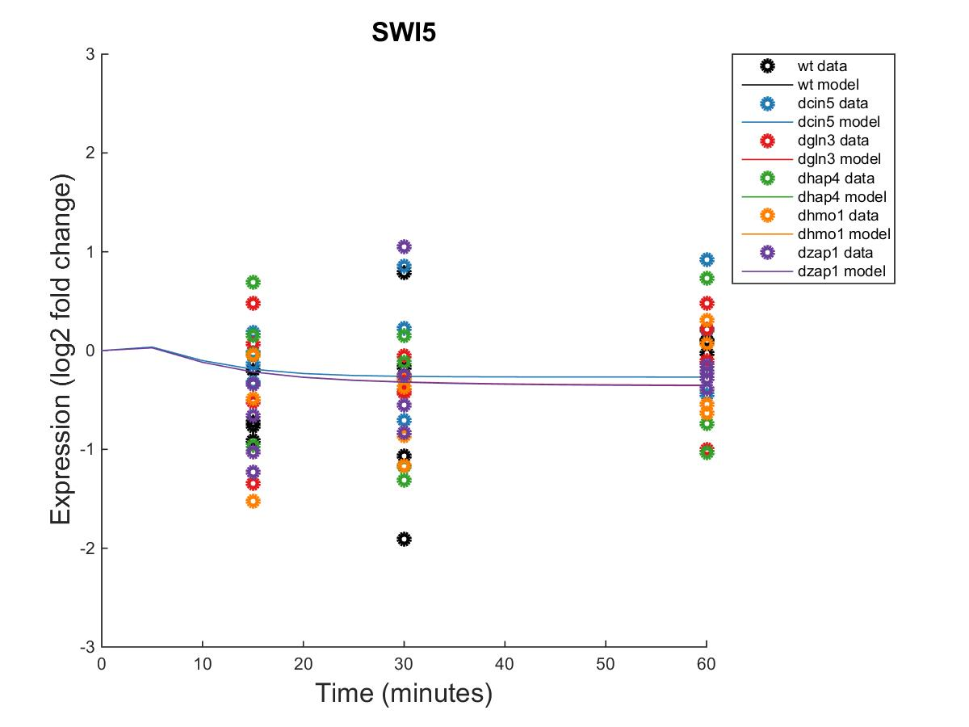
db5: Edge-Derived Hypothesis Network

Slide 16
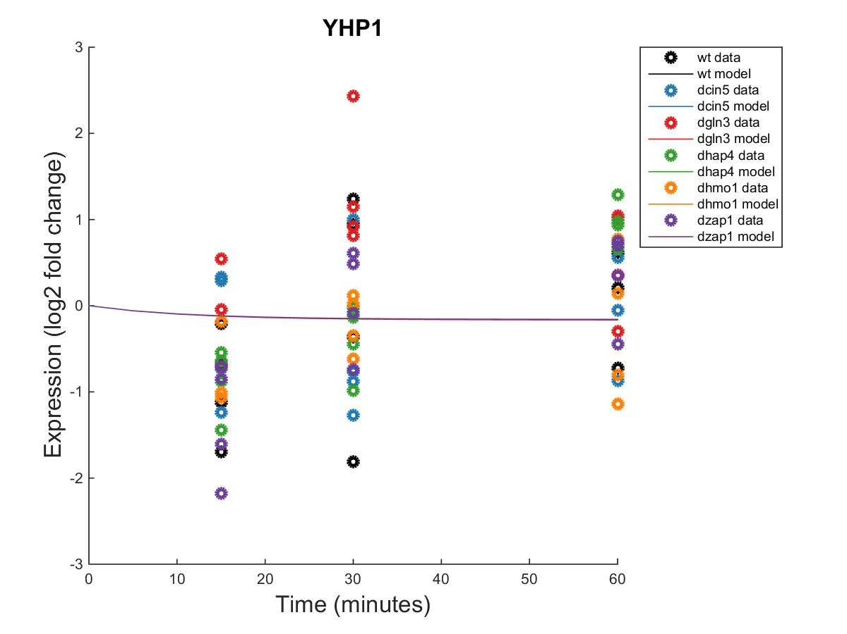
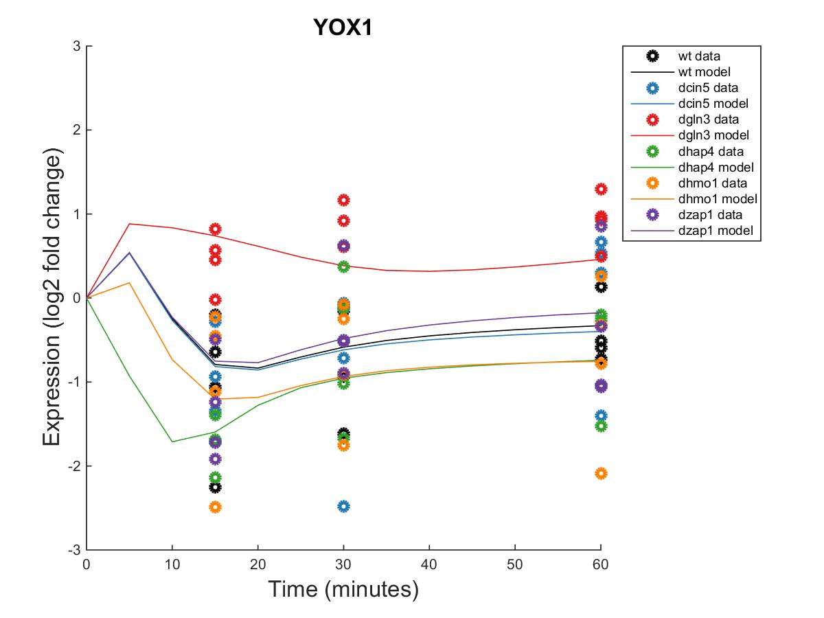

db5: Edge-Derived Hypothesis Network

Slide 17
db5: Edge-Derived Hypothesis Network
id | production_rate | threshold_b
ACE2 | 0.8863 | 0.3961
ASH1 | 0.2867 | 0.0000
CIN5 | 2.0030 | -1.0371
GCR2 | 0.4075 | 1.4111
GLN3 | 0.3946 | 0.0000
HAP4 | 1.5371 | 1.1963
HMO1 | 0.2273 | -0.0142
MSN2 | 1.3938 | 1.4951
SFP1 | 0.9077 | -0.3094
STB5 | 0.3311 | 0.8698
SWI4 | 1.7434 | -1.3193
SWI5 | 1.1492 | -0.3738
YHP1 | 0.4917 | 1.7410
YOX1 | 2.5456 | 1.4768
ZAP1 | 0.1306 | 0.0000

Slide 18
db5: MSE-Derived Hypothesis Network
15 Nodes and 28 Edges
All valid inputs to nodes with the lowest average MSE among db5 and the 5 best performing db5-derived random networks were selected until an edge list of 28 regulatory relationships was obtained.
Parameter | Value
LSE | 0.6948
Penalty | 3.1129
min LSE | 0.4851
iteration count | 100023
LSE:minLSE ratio | 1.4321

Slide 19
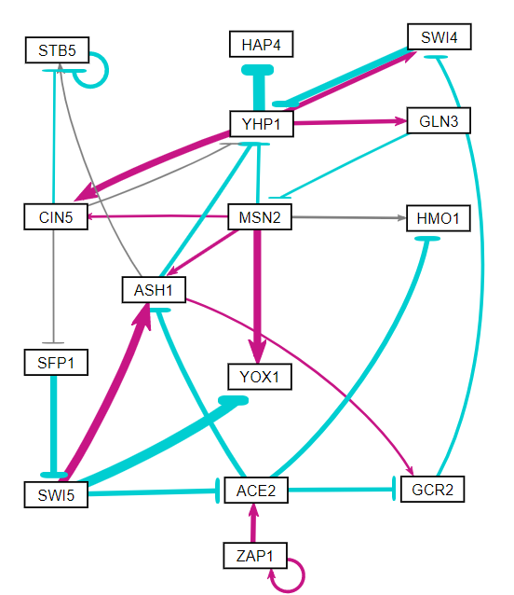
db5: Edge-Derived Hypothesis Network

Slide 20
db5: Edge-Derived Hypothesis Network
Gene | wt MSE | dcin5 MSE | dgln3 MSE | dhap4 MSE | dhmo1 MSE | dzap1 MSE
ACE2 | 0.4249 | 0.0937 | 1.3147 | 0.1339 | 0.2009 | 0.8888
ASH1 | 0.3874 | 0.5872 | 0.4906 | 0.4009 | 1.3404 | 1.1711
CIN5 | 0.8060 | 0.1450 | 0.8739 | 1.2710 | 1.0619 | 0.9229
GCR2 | 0.4099 | 0.6968 | 0.7726 | 0.9896 | 0.4981 | 0.2137
GLN3 | 0.4964 | 0.2069 | 0.3533 | 0.2134 | 0.2921 | 0.1752
HAP4 | 1.9577 | 1.3108 | 0.8106 | 0.4916 | 1.4597 | 0.4224
HMO1 | 0.6693 | 0.7758 | 0.3089 | 2.7343 | 0.5936 | 0.4066
MSN2 | 0.5250 | 0.2613 | 0.7733 | 0.3014 | 0.5340 | 0.2985
SFP1 | 0.9901 | 0.2705 | 0.9650 | 0.1798 | 1.1666 | 0.3012
STB5 | 1.9227 | 0.8525 | 0.2963 | 0.1428 | 0.7435 | 1.3169
SWI4 | 0.3596 | 0.5658 | 0.3896 | 0.1937 | 0.2795 | 0.2501
SWI5 | 0.5013 | 0.4095 | 0.2873 | 0.4549 | 0.3099 | 0.3619
YHP1 | 0.7918 | 0.7008 | 1.4312 | 0.6220 | 0.3819 | 0.5878
YOX1 | 0.3867 | 0.7737 | 0.1116 | 0.4265 | 0.6706 | 0.4577
ZAP1 | 2.2721 | 0.6898 | 1.3018 | 1.1306 | 0.4474 | 3.1590

Slide 21
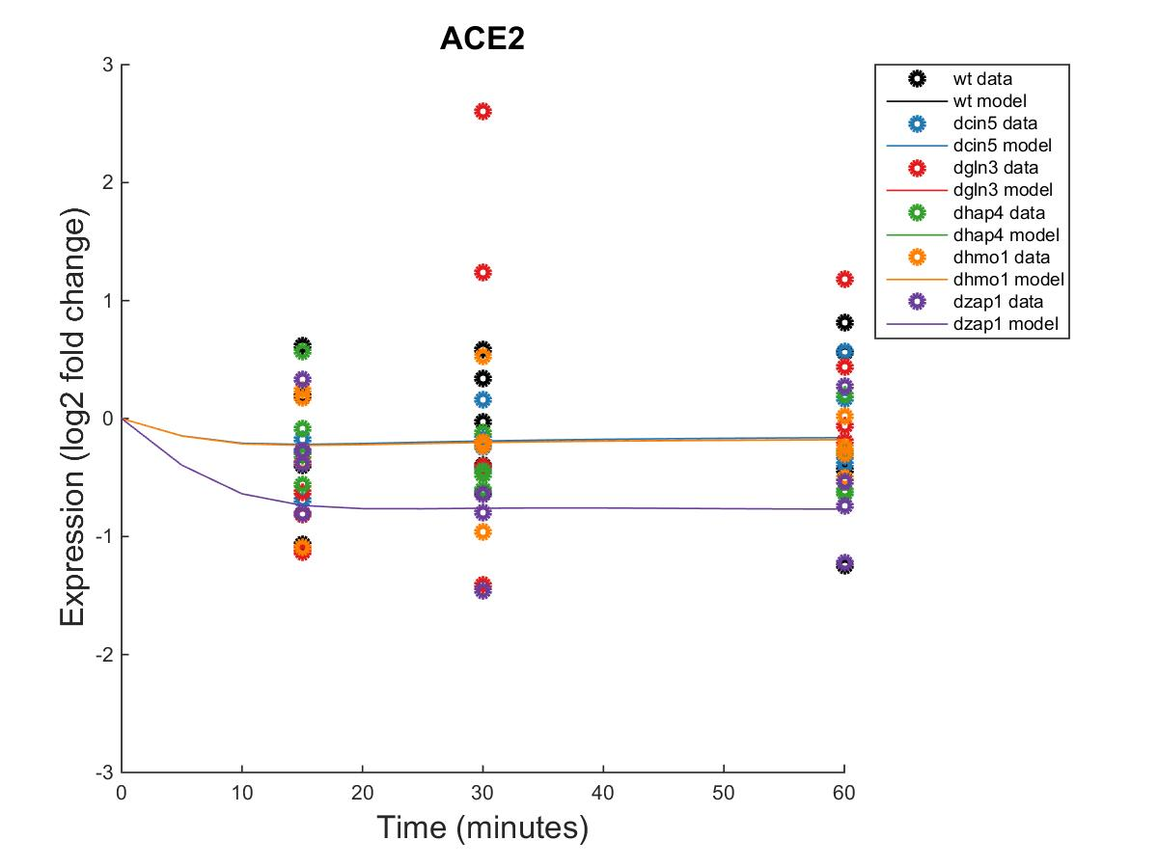
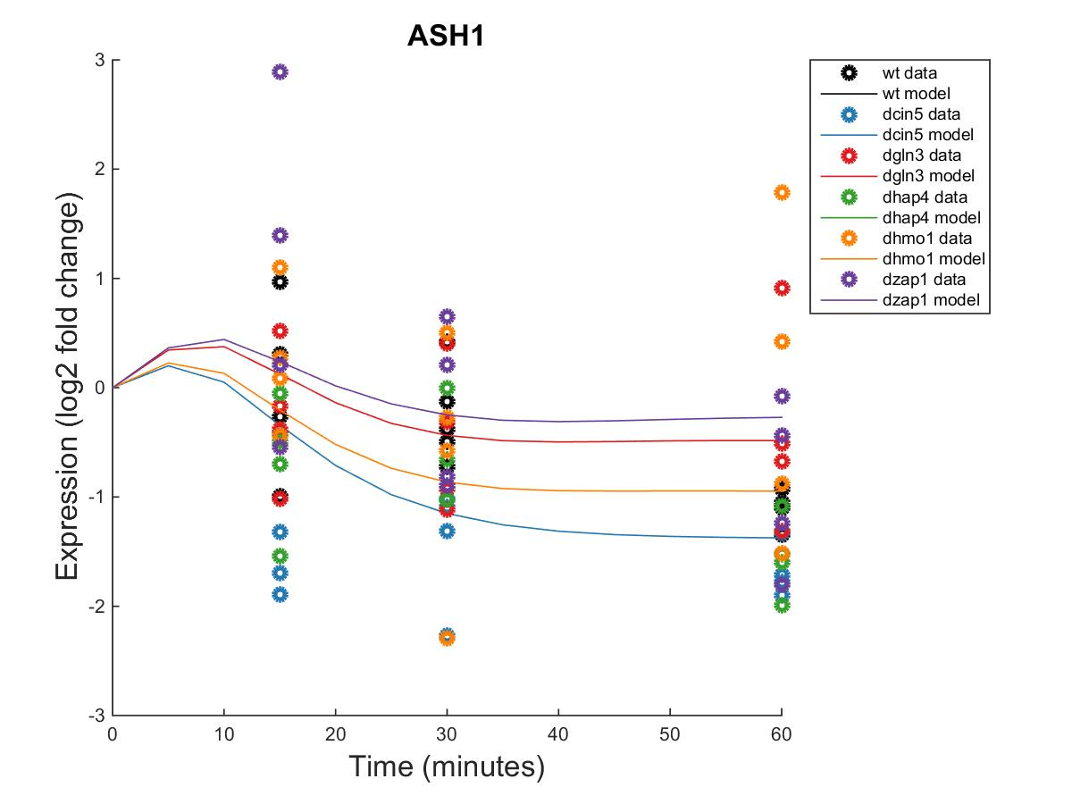

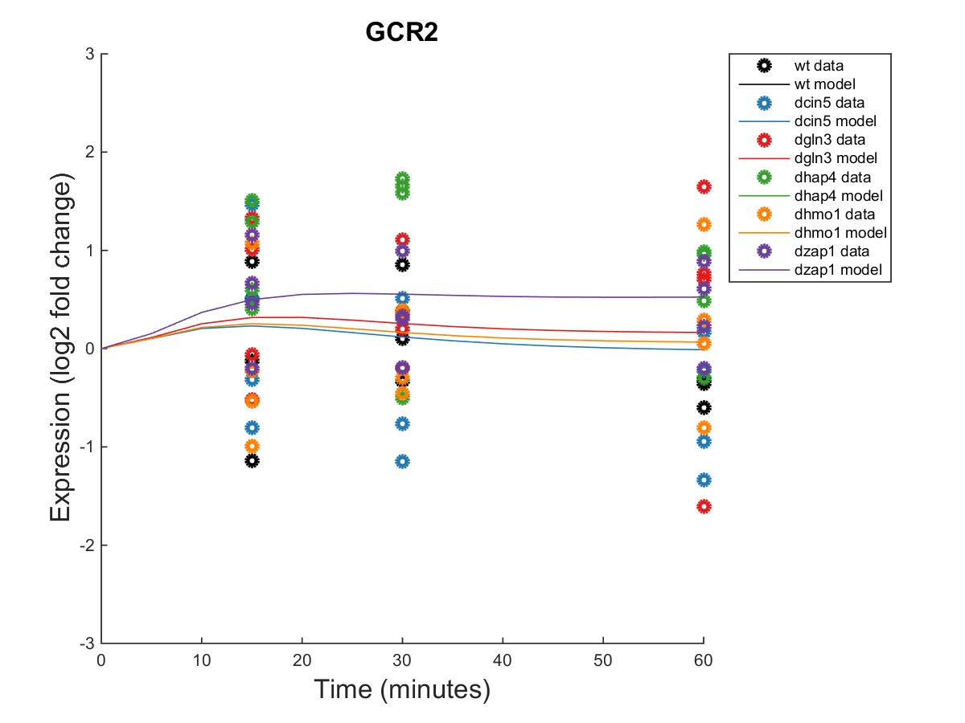
db5: Edge-Derived Hypothesis Network

Slide 22
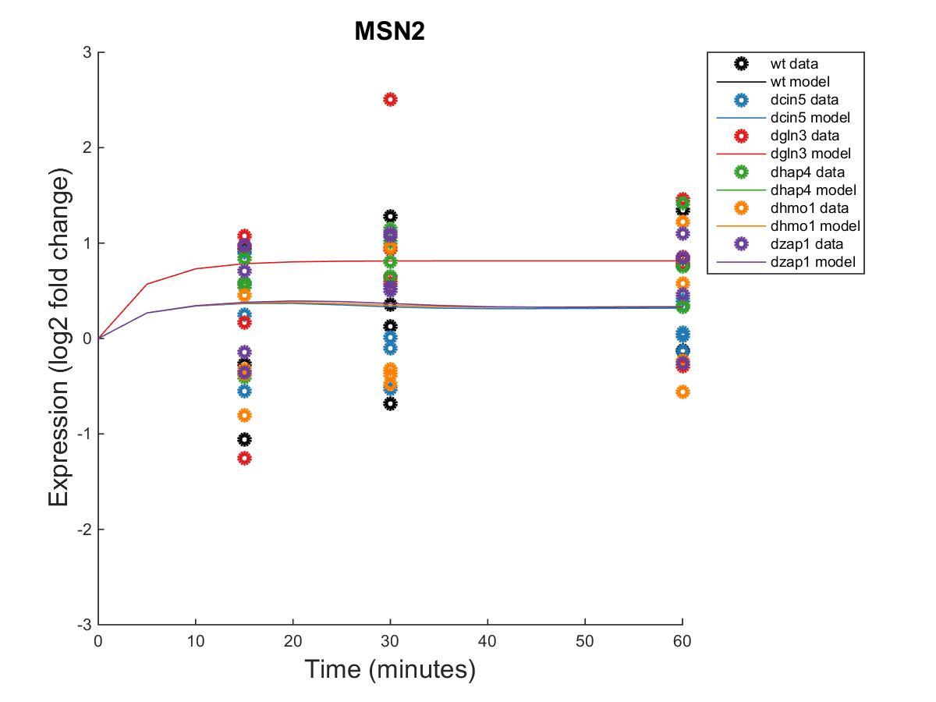
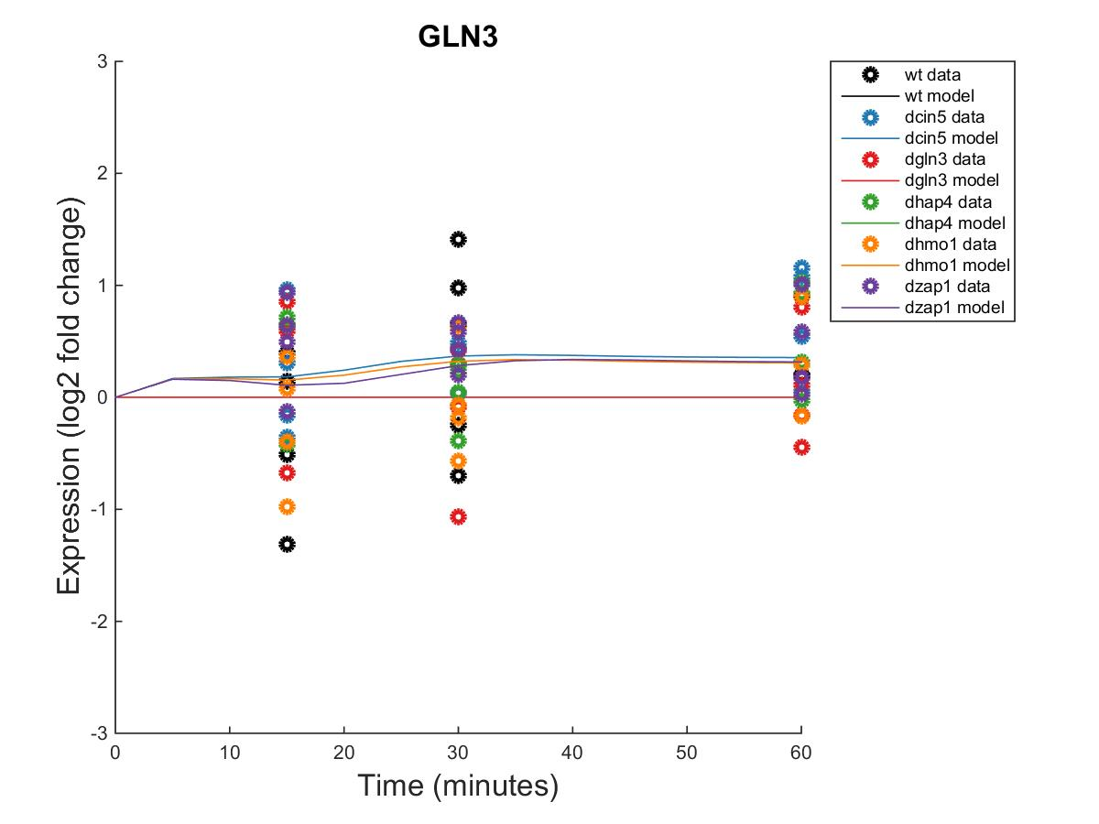
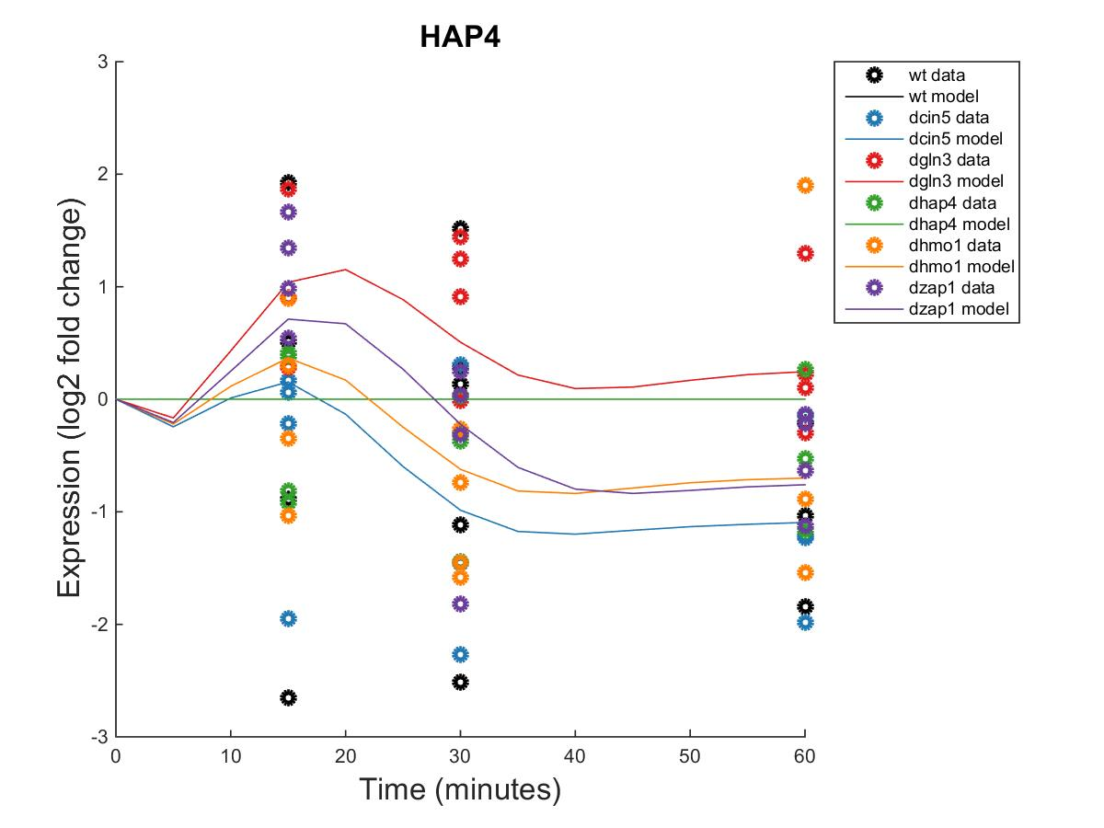
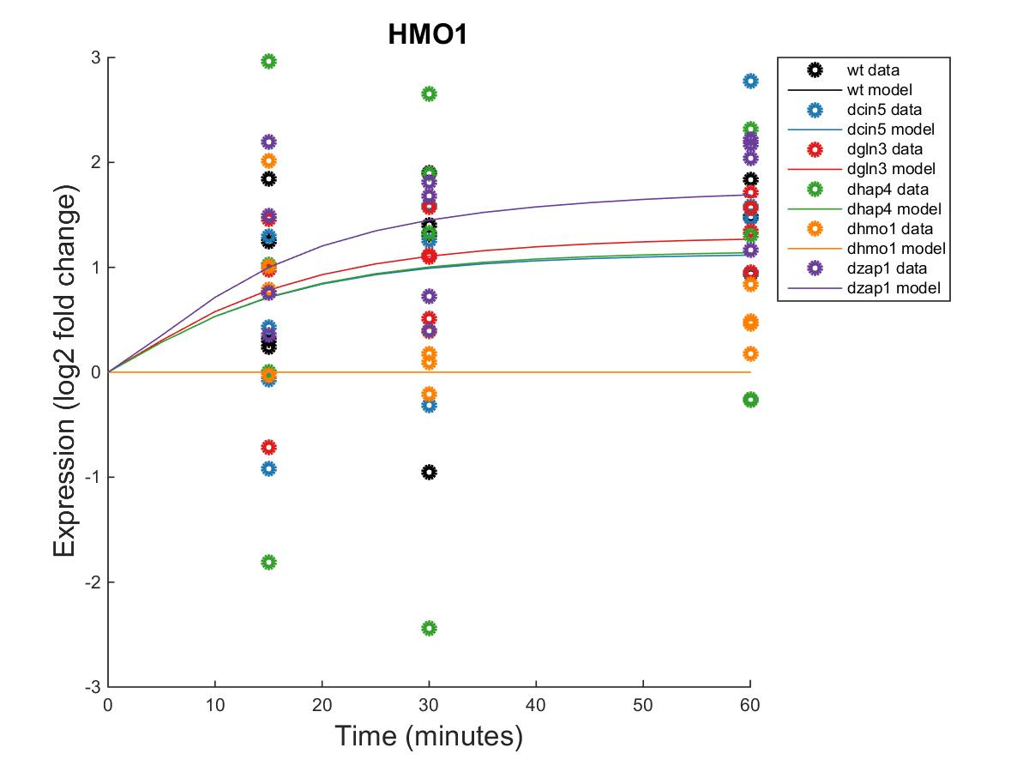
db5: Edge-Derived Hypothesis Network

Slide 23
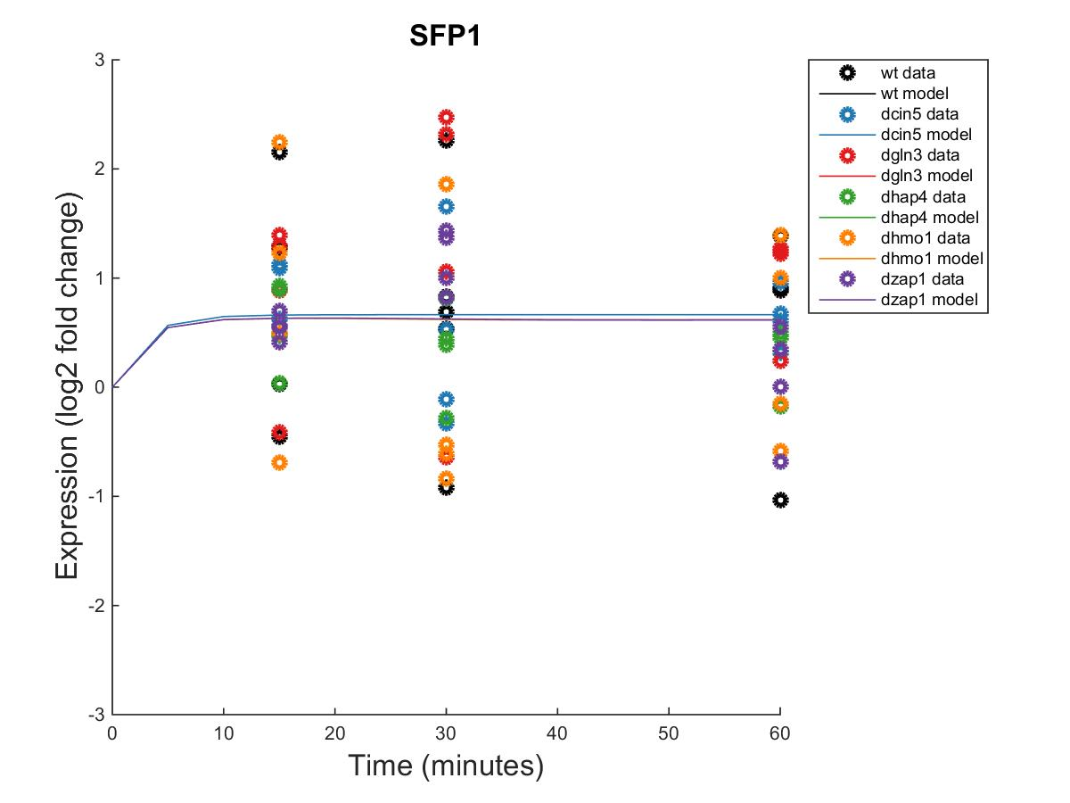
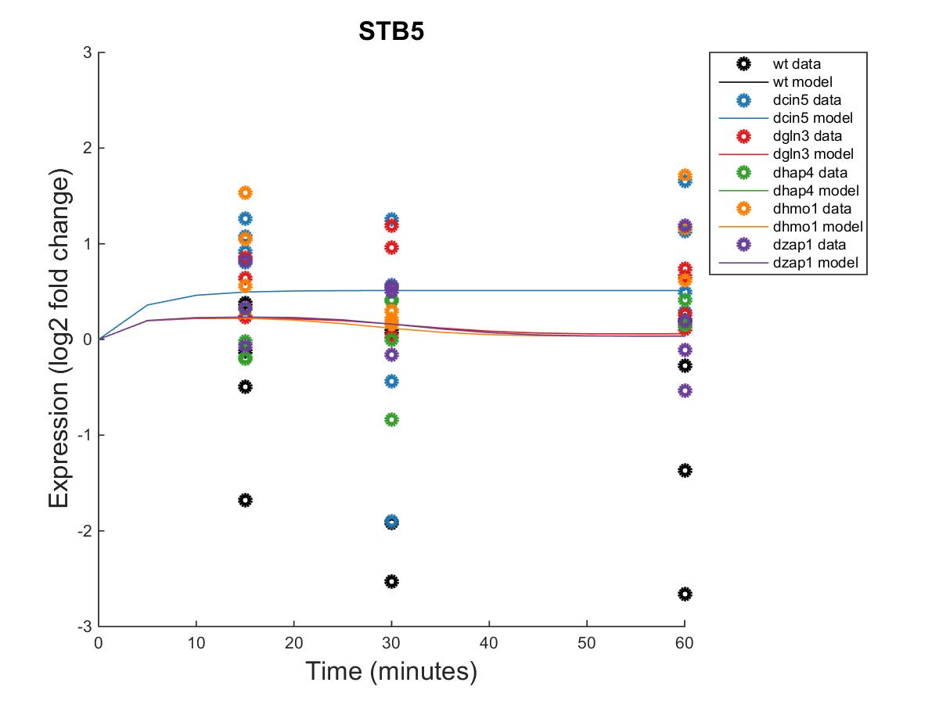
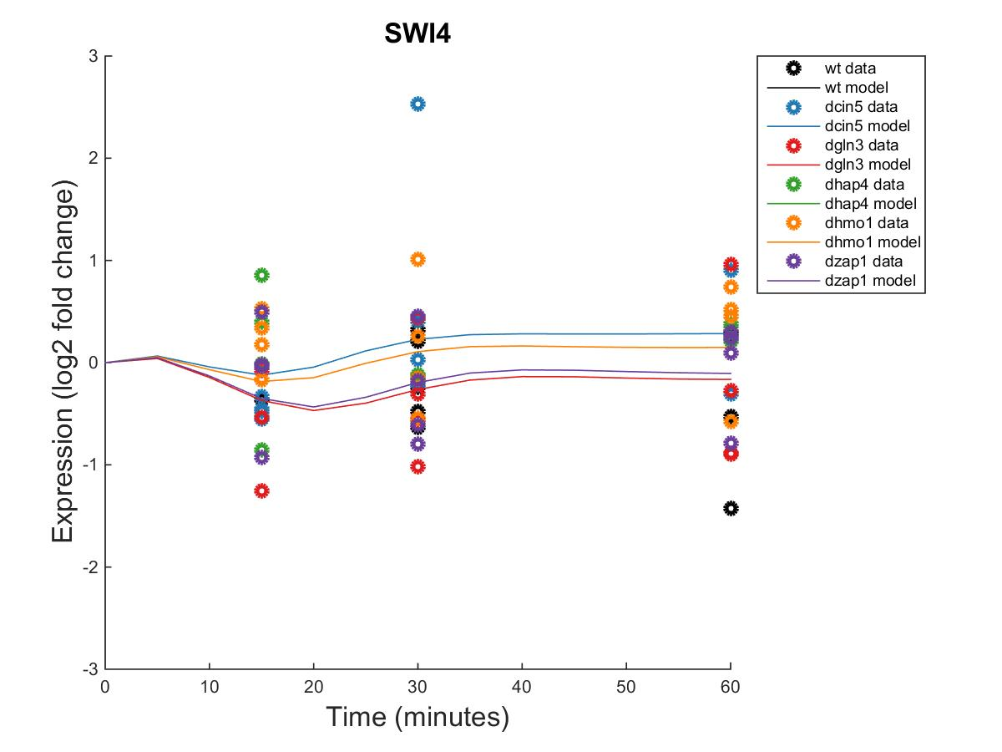
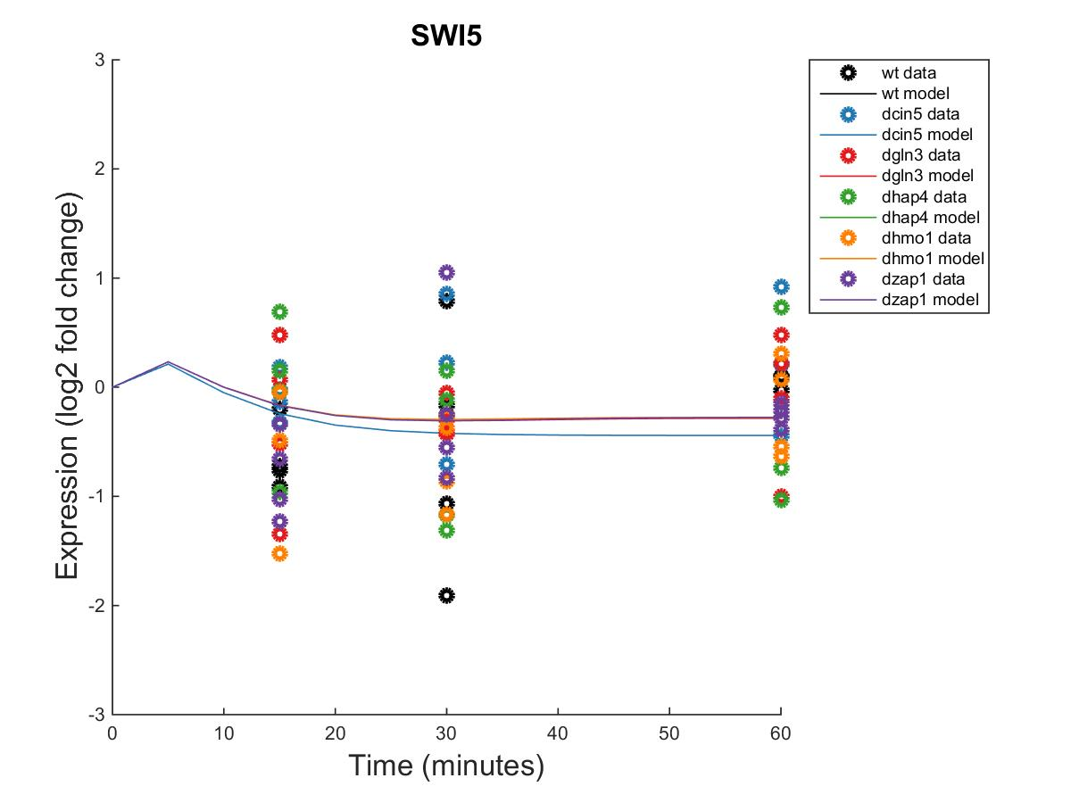
db5: Edge-Derived Hypothesis Network

Slide 24
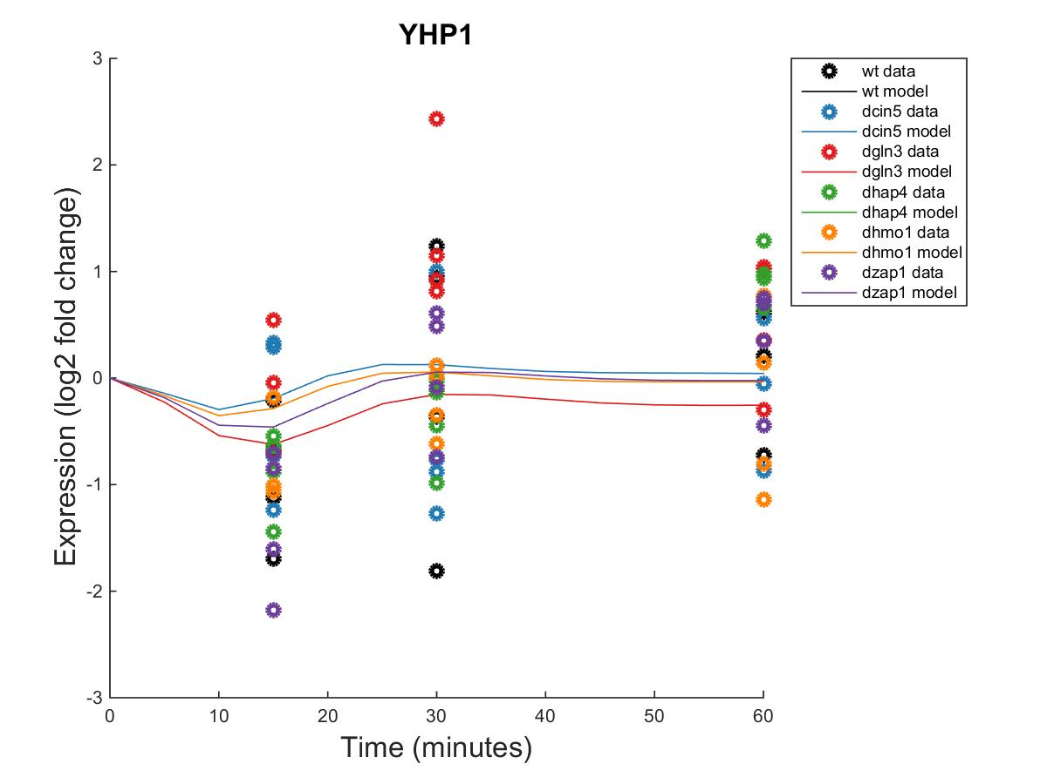
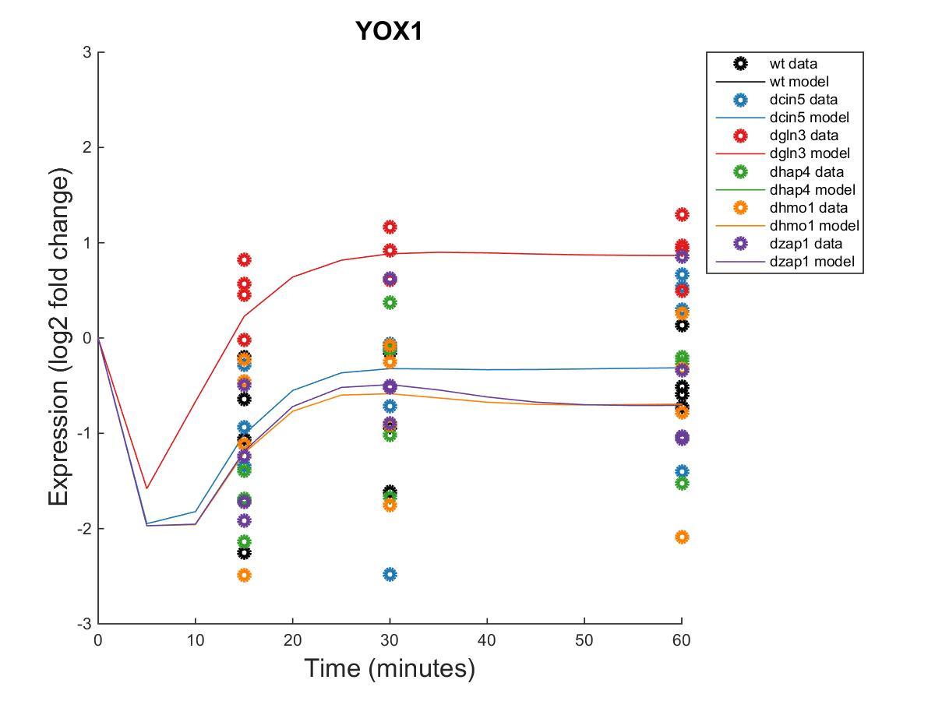

db5: Edge-Derived Hypothesis Network

Slide 25
db5: Edge-Derived Hypothesis Network
id | production_rate | threshold_b
ACE2 | 0.1088 | -1.8053
ASH1 | 1.4728 | 4.5412
CIN5 | 0.9933 | 3.8563
GCR2 | 0.3759 | 0.2880
GLN3 | 0.4148 | 1.1840
HAP4 | 2.7270 | -1.4606
HMO1 | 0.6333 | 0.2795
MSN2 | 0.8899 | 0.3938
SFP1 | 1.0227 | -0.1487
STB5 | 0.7731 | -0.1549
SWI4 | 0.5445 | 1.9539
SWI5 | 1.5458 | -1.2663
YHP1 | 1.4138 | -1.7929
YOX1 | 1.4556 | 2.1160
ZAP1 | 0.1169 | 0.7335

Slide 26
db8 Hypothesis Network
15 Nodes and 27 Edges
“Meta-analysis” network composed of the 27 valid edges appearing in 3+ networks (6 database-derived + 5 best performing randoms)
Parameter | Value
LSE | 0.6736
Penalty | 2.2690
min LSE | 0.4651
iteration count | 54537
LSE:minLSE ratio | 1.4484

Slide 27
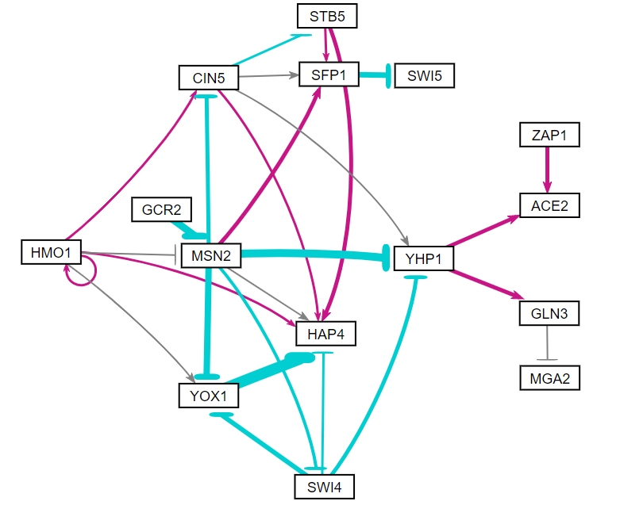
db8 Hypothesis Network

Slide 28
db8 Hypothesis Network
Gene | wt MSE | dcin5 MSE | dgln3 MSE | dhap4 MSE | dhmo1 MSE | dzap1 MSE
ACE2 | 0.4211 | 0.0910 | 1.2710 | 0.1630 | 0.2108 | 0.7805
CIN5 | 0.8330 | 0.1450 | 0.8798 | 1.0712 | 0.7710 | 0.6609
GCR2 | 0.4947 | 0.8786 | 0.7756 | 0.9136 | 0.4926 | 0.2362
GLN3 | 0.4960 | 0.2325 | 0.3533 | 0.1786 | 0.2700 | 0.1613
HAP4 | 2.1496 | 1.1858 | 1.3481 | 0.4916 | 1.3955 | 0.5502
HMO1 | 0.6170 | 0.6674 | 0.2977 | 2.8409 | 0.5936 | 0.5224
MGA2 | 0.5180 | 0.1296 | 0.1331 | 0.1810 | 0.2896 | 0.3743
MSN2 | 0.5975 | 0.2717 | 0.9525 | 0.3340 | 0.6220 | 0.3362
SFP1 | 0.9838 | 0.2664 | 0.9795 | 0.1769 | 1.1321 | 0.2946
STB5 | 1.8407 | 0.8729 | 0.3636 | 0.1720 | 0.5284 | 1.3379
SWI4 | 0.3059 | 0.6793 | 0.4597 | 0.1960 | 0.3274 | 0.2496
SWI5 | 0.3997 | 0.2341 | 0.2770 | 0.4805 | 0.2614 | 0.2929
YHP1 | 0.7367 | 0.6076 | 1.0762 | 0.2557 | 0.3451 | 0.5414
YOX1 | 0.4143 | 0.7579 | 1.4506 | 0.7282 | 0.6634 | 0.4993
ZAP1 | 2.2952 | 0.6714 | 1.2842 | 1.1330 | 0.4641 | 3.1590

Slide 29
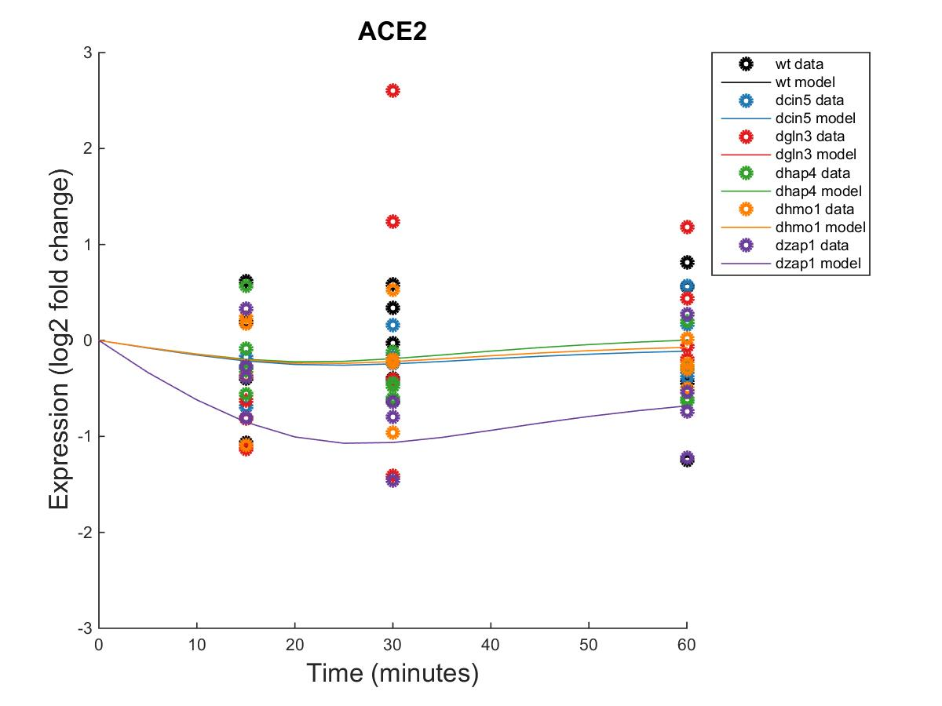
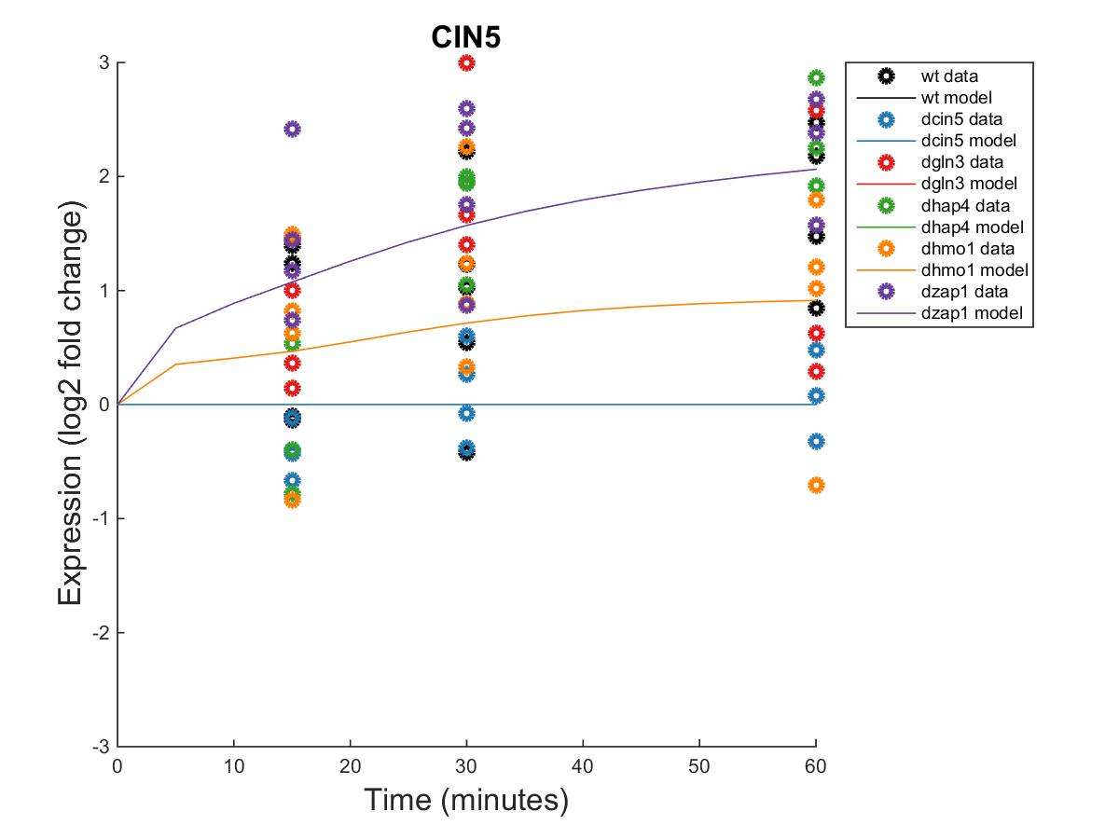
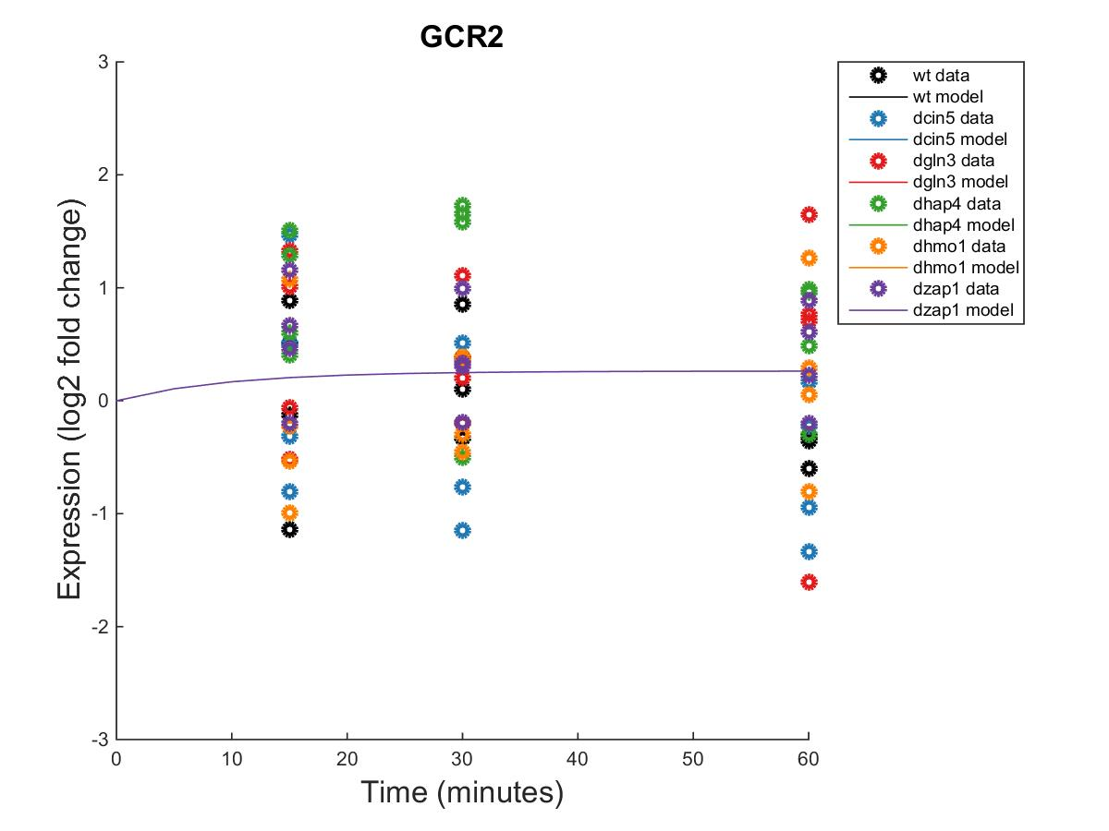
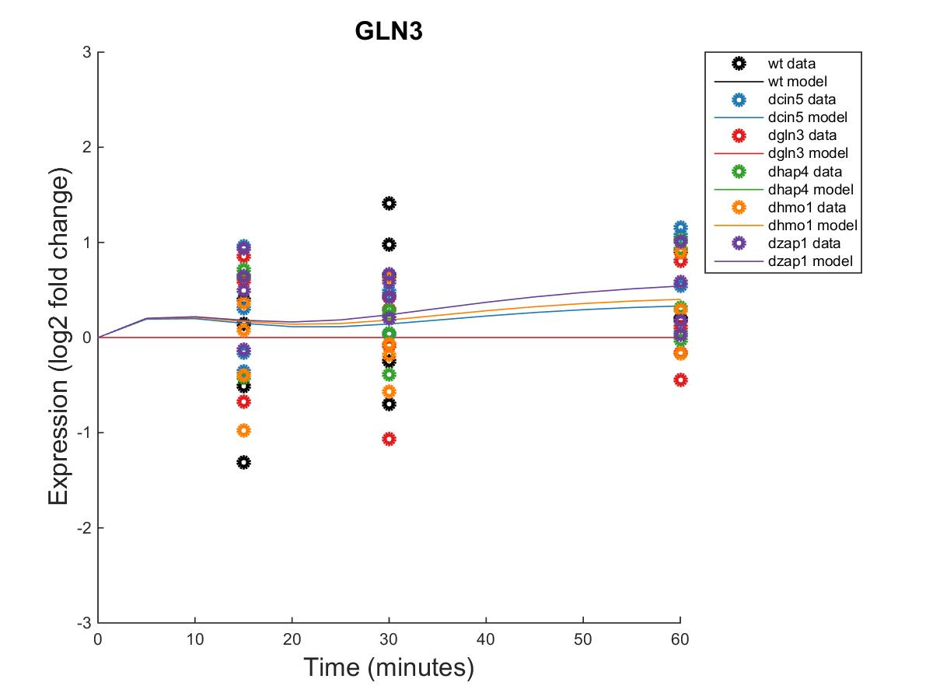
db8 Hypothesis Network

Slide 30

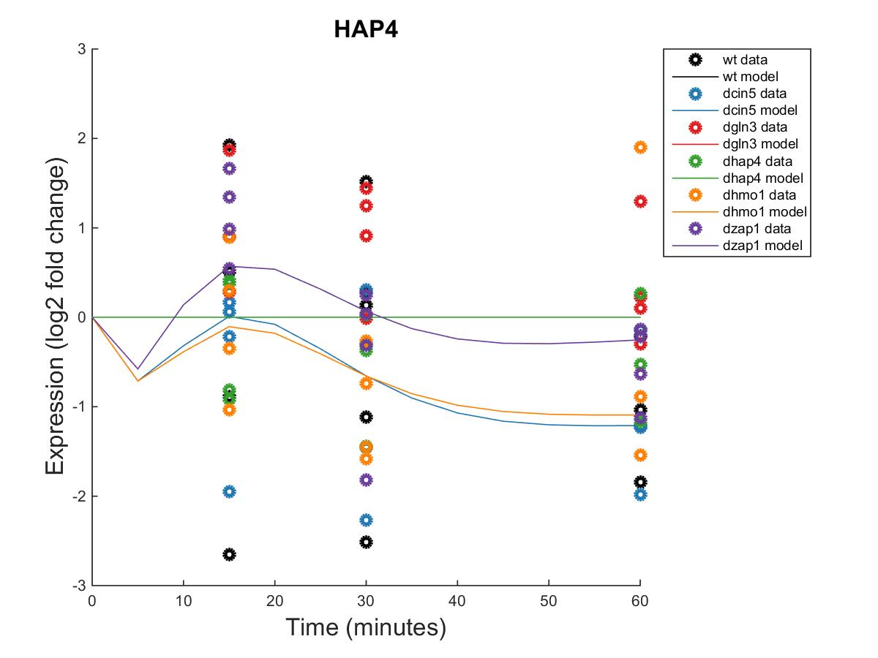


db8 Hypothesis Network

Slide 31




db8 Hypothesis Network

Slide 32



db8 Hypothesis Network

Slide 33
db8 Hypothesis Network
id | production_rate | threshold_b
ACE2 | 0.1353 | 1.4222
CIN5 | 1.0554 | 0.1643
GCR2 | 0.2310 | 0.0000
GLN3 | 0.3310 | 0.6563
HAP4 | 1.6432 | 1.9479
HMO1 | 0.2532 | 1.1660
MGA2 | 0.2054 | -0.0159
MSN2 | 2.2817 | -1.5304
SFP1 | 1.1795 | 2.3411
STB5 | 0.1900 | -0.3504
SWI4 | 0.6461 | 0.0064
SWI5 | 1.3115 | -0.9095
YHP1 | 1.9291 | -2.7267
YOX1 | 2.3270 | -2.4454
ZAP1 | 0.1303 | 0.0000

